Slide 1
"Trust the token, not the network — every hop is a new perimeter."
SUPPLEMENTARY · MODULE 7
Microservices
Security
Secure service-to-service and user paths: OAuth2/OIDC, JWT, mTLS, secrets on OpenShift, and the controls that satisfy banking audit.
🔒
🔑
🛡️
🏦
SPRING BOOT MICROSERVICES BOOTCAMP • DAY 3 • MODULE 7
Notes:
KEY TALKING POINTS
------------------
- Why security is today's second module
Lab 2 left Account Service on port 8081 and Transaction Service on port 8082 working and still open.
Anyone who can reach the port can create an account or post a transfer.
Module 7 explains the controls that close that gap: OAuth2 and OpenID Connect, JWT access tokens, scopes, and defense in depth.
The quote on the divider is the thesis.
Trust the token, not the network.
An OpenShift cluster network is not a perimeter once two services call each other.
- What Lab 3 actually implements
The classroom uses HS256 JWTs from issue-jwt.py, not a live bank IdP.
Scopes are accounts.read, accounts.write, transactions.read, and transactions.write.
Each API is a Spring Security resource server: no Bearer token is 401, the wrong scope is 403.
Transaction Service relays the caller's token when it reads an account so Account Service still authorizes the original identity.
Secrets and mTLS appear as concepts; Day 4 puts secrets on OpenShift.
Risk Assessment Service on Day 5 will follow the same token habit.
- Trust the token, not the network
Internal is not the same as trusted.
A misconfigured route, a compromised pod, or a developer laptop on the cluster network can call an unauthenticated API.
Every hop validates the JWT again: signature, expiry, and required scope.
Relaying the Bearer token keeps the caller's scopes visible at Account Service instead of letting Transaction Service speak with a superuser identity.
That is the banking audit story: who called, what they were allowed to do, and why the service said yes or no.
REAL-WORLD EXAMPLES
-------------------
- Retail-banking APIs normally sit behind an identity provider that issues short-lived tokens.
Each account or payment API validates the token itself.
A private corporate network is not treated as proof of identity, which is the same stance this module takes.
USE-CASE SCENARIO
-----------------
Frame Module 7 as the security review the capstone still has to pass.
A branch application wants to post transfers through Transaction Service on port 8082 and read accounts on port 8081.
Today those calls have no token.
By the end of Lab 3 a teller token can manage accounts but receives 403 on a transaction write, an ops token can post a transfer and is relayed to Account Service with accounts.read, and a missing token is 401.
The Resilience4j fallback still returns 503 ACCOUNT_SERVICE_UNAVAILABLE if the account lookup fails.
Risk scoring stays on Day 5, and it will require a token too.

Slide 2
SECURITY THREATS IN DISTRIBUTED SYSTEMS
Unauthorized access, insecure service communication, injection, and misconfiguration top the list of threats a distributed architecture introduces.
📌
COMMON THREATS
✅
BEST PRACTICES TO REDUCE RISK
• Unauthorized access, insecure service-to-service communication, vulnerable components
• Data exposure, injection attacks, denial of service
• Supply chain attacks and misconfiguration
• Enforce strong authentication and authorization; encrypt data in transit and at rest
• Implement network policies, manage secrets securely, monitor and alert continuously
KEY TAKEAWAY Unauthorized access, insecure service communication, injection, and misconfiguration top the list of threats a distributed architecture introduces.
1
© 2026 by Innovation In Software Corporation
Notes:
KEY TALKING POINTS
------------------
- COMMON THREATS
A distributed banking platform multiplies doors.
Unauthorized access is a missing or forged token on Account Service or Transaction Service.
Insecure service-to-service calls are HTTP without validation between those two ports.
Vulnerable components and supply-chain risk arrive through a Maven dependency.
Injection and data exposure show up as unsanitized input or a token printed in a log.
Denial of service can be a flood of POSTs that never trip a breaker.
Misconfiguration is the quiet one: a security matcher left on permitAll after a demo.
- BEST PRACTICES TO REDUCE RISK
Authenticate every caller and authorize every money-moving method.
Encrypt in transit with TLS and protect data at rest in PostgreSQL.
Network policies on OpenShift limit which pods can reach port 8081 or 8082.
Secrets belong in a secret manager or an OpenShift Secret, not in application.yml committed to Git.
Continuous monitoring and alerting turn a burst of 401s or a breaker opening into a signal instead of a surprise.
None of these replaces the others.
That is why the next slides talk about layers rather than a single control.
REAL-WORLD EXAMPLES
-------------------
- A partner fintech with an overly broad API key once pulled more customer records than its contract allowed.
Banks now issue scoped tokens and log every access so that kind of over-read is visible and stoppable.
- Enterprise incident reviews often find a logging statement that printed an Authorization header during a timeout investigation.
The fix is redaction and secret hygiene, which Lab 3 also requires: tokens and claims stay out of logs.
USE-CASE SCENARIO
-----------------
Security review looks at the AI-Assisted Banking Transaction Risk Platform after Lab 2.
Account Service on port 8081 and Transaction Service on port 8082 accept any caller.
A laptop on the same network can freeze an account or post a transfer.
Module 7 and Lab 3 close that with HS256 classroom JWTs, scopes accounts.read, accounts.write, transactions.read, and transactions.write, and Bearer token relay on the account lookup.
If Account Service is down, the Resilience4j fallback still returns 503 ACCOUNT_SERVICE_UNAVAILABLE and never invents ACTIVE.
Day 5 Risk Assessment will be another entry point and will need the same controls.

Slide 3
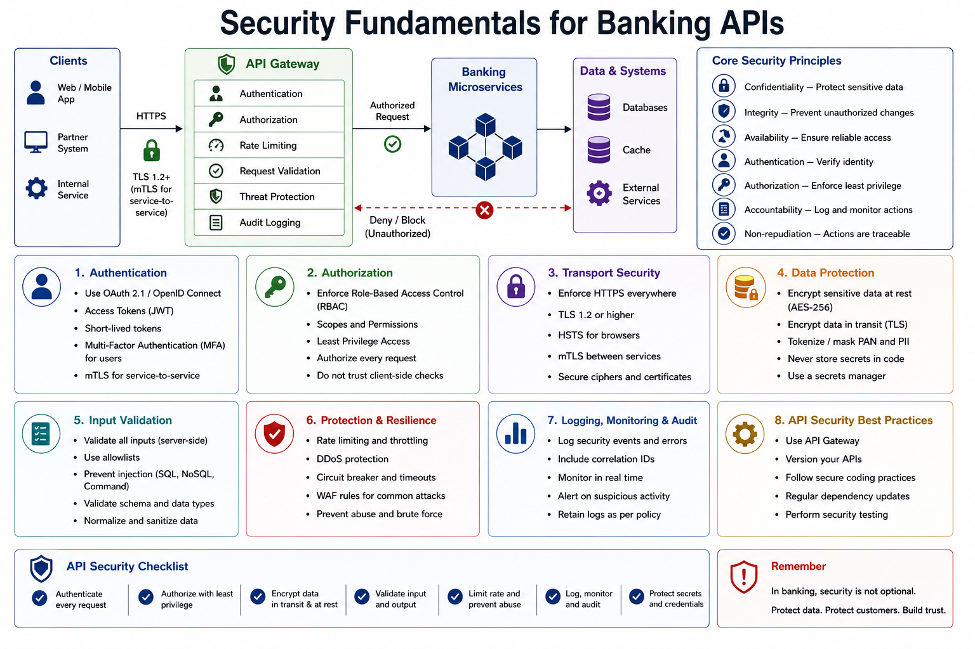
2
© 2026 by Innovation In Software Corporation
Notes:
KEY TALKING POINTS
------------------
- Clients, gateway, and the service path
Web, mobile, partner, and internal callers reach banking APIs over HTTPS, often with TLS 1.2 or higher and mTLS for service-to-service links.
Many enterprises put an API gateway in front for authentication, authorization, rate limits, validation, threat protection, and audit.
The MD287 capstone has no gateway.
Transaction Service on port 8082 calls Account Service on port 8081 directly, and each Spring Boot resource server validates the JWT itself.
The picture is still useful: every hop in that path is a place to deny an unauthorized request before it touches PostgreSQL.
- Core security principles
Confidentiality, integrity, and availability are the classic triad.
Authentication asks who the caller is.
Authorization enforces least privilege on what they may do.
Accountability and non-repudiation mean actions are logged and attributable.
For this course those principles become concrete: a Bearer token identifies the classroom subject, scopes such as accounts.read or transactions.write limit the method, and a correlation id plus an audit-friendly log line record the decision without printing the token.
- Eight control families
The numbered boards are a map, not a shopping list for today.
Lab 3 implements authentication and authorization with HS256 JWTs and method scopes.
Input validation already exists on the controllers.
Resilience from Module 6 sits beside security: a breaker and a 503 protect availability.
Transport security, encryption at rest, secrets managers, WAF rules, and formal API versioning are enterprise layers participants should recognize.
Day 4 adds OpenShift secrets and network posture.
Do not try to install all eight before the lab.
- Security is not optional in banking
The checklist repeats the same decisions: authenticate every request, authorize with least privilege, encrypt, validate, limit abuse, log and audit, and protect secrets.
The reminder is cultural.
In a retail bank, an API that works without a token is not a prototype success; it is a finding.
Customers trust the institution with balances and transfers.
The platform earns that trust by refusing anonymous calls and by failing closed when identity or a dependency is uncertain.
REAL-WORLD EXAMPLES
-------------------
- A mobile-banking app typically authenticates the customer at an identity provider, then calls account and payment APIs with a short-lived access token.
Each API checks the token again rather than trusting the mobile client or the private network.
- Internal enterprise batch jobs that once used a shared database login are commonly moved onto client credentials or mTLS so the job has a name, a scope, and an audit trail of its own.
USE-CASE SCENARIO
-----------------
Walk the capstone across the diagram without inventing a gateway.
A teller client sends HTTPS to Transaction Service on port 8082 with an HS256 Bearer token that carries transactions.write and accounts.read.
Transaction Service validates the token, then relays the same Authorization header to Account Service on port 8081.
Account Service validates again and requires accounts.read before returning status.
If the token is missing, either API returns 401.
If the scope is wrong, 403.
If Account Service is down, Resilience4j returns 503 ACCOUNT_SERVICE_UNAVAILABLE and never invents ACTIVE.
Day 5 Risk Assessment will hang off the same event path and will need its own authenticated entry points.

Slide 4
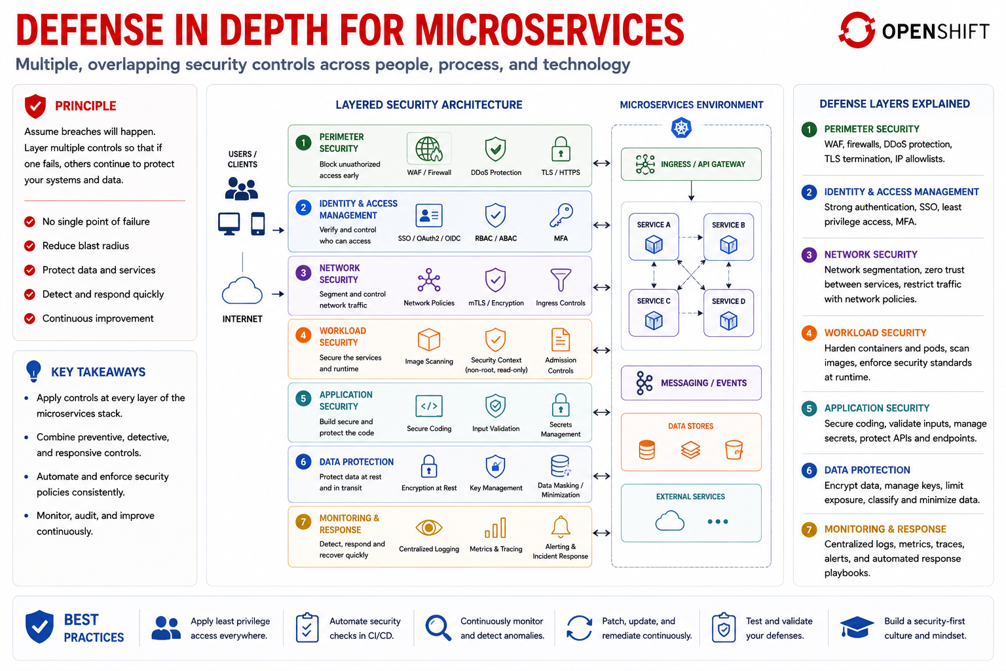
3
© 2026 by Innovation In Software Corporation
Notes:
KEY TALKING POINTS
------------------
- THE SEVEN DEFENSE LAYERS
Each layer catches a different miss.
Perimeter controls who reaches the cluster.
Identity decides who the caller is.
Network policies limit which pods talk to Account Service on port 8081.
Workload security covers the container and its service account.
Application security is Spring Security, validation, and safe fallbacks.
Data protection is encryption and least-privilege database roles.
Monitoring is how a burst of 401s or an open circuit becomes a page.
A bank that only has a perimeter firewall is one misrouted pod away from an open API.
- PRINCIPLE
Assume a breach will happen and design so one failed control is not the whole story.
If a token is stolen, short expiry and scope limits reduce the blast.
If a matcher is wrong, network policy may still block the caller.
If a pod is compromised, the database credential should not also unlock every other service.
Defense in depth is not duplication for its own sake.
It is independent controls that fail differently.
Lab 3 is one layer: JWT validation on each service.
It does not replace OpenShift, secrets hygiene, or the 503 fallback.
REAL-WORLD EXAMPLES
-------------------
- A stolen teller password is less damaging when MFA is on, the session token expires quickly, the API still checks accounts.write, and audit logs show the unusual account list.
Any one of those layers can be the one that holds.
- Enterprise platforms often pair an identity-aware proxy with pod network policies.
An internal reporting tool that is authenticated but running in the wrong namespace still cannot open a connection to the payments database.
USE-CASE SCENARIO
-----------------
Picture a reviewer asking how the AI-Assisted Banking Transaction Risk Platform survives a leaked classroom token.
The HS256 secret must stay out of Git.
The token is short-lived.
Account Service on port 8081 still requires accounts.read or accounts.write.
Transaction Service on port 8082 still requires transactions.write for a POST and relays the caller token rather than using a superuser.
If Account Service is unreachable, the Resilience4j fallback returns 503 ACCOUNT_SERVICE_UNAVAILABLE instead of guessing ACTIVE.
Day 4 adds OpenShift Secrets and network policy.
Day 5 adds another service that must not skip these layers.

Slide 5
AUTHENTICATION VS. AUTHORIZATION · IDENTITY AND ACCESS MANAGEMENT · OAUTH 2.0 FUNDAMENTALS
📌
AUTHENTICATION: WHO ARE YOU?
🔑
AUTHORIZATION: WHAT CAN YOU DO?
📌
HOW IAM WORKS
• Verifies identity: username/password, MFA, OAuth2/OIDC login, API key or certificate
• Checks permissions: roles, scopes in an access token, ACLs, resource-level permissions
• First prove who you are, then determine what you can do
• Identities (users, services, apps, devices) -> Authentication -> Authorization -> Access
• Continuous monitoring wraps around the entire flow
✅
COMMON IAM CAPABILITIES
📌
CORE ROLES
✅
BEST PRACTICES
• Single sign-on (SSO), multi-factor authentication, RBAC, ABAC
• Privileged access management (PAM), identity federation and social login
• Resource owner: the user who owns the data
• Client: the application requesting access on the user's behalf
• Authorization server: authenticates the user and issues access tokens
• Resource server: hosts the protected resources
• Use least-privilege scopes; always use HTTPS; validate tokens on the resource server
• Keep tokens short-lived and never store sensitive data in an access token
KEY TAKEAWAY A customer may prove who they are through login, but authorization is the separate check that decides which accounts they can actually view. • Identities, authentication, authorization, and access flow through one governed framework -- with audit and monitoring wrapped around all of it. • Resource owner, client, authorization server, and resource server are OAuth2's four roles -- each with one clear responsibility.
4
© 2026 by Innovation In Software Corporation
Notes:
TOPIC 1 OF 3: Authentication vs. Authorization
------------------------------------------
KEY TALKING POINTS
------------------
- AUTHENTICATION: WHO ARE YOU?
Authentication is the proof of identity, not the permission slip.
A password plus MFA, an OIDC login, a client certificate, or a signed JWT all answer the same question: is this the subject we think it is.
In Lab 3 that proof is an HS256 JWT in the Authorization Bearer header.
Spring Security validates the signature and expiry.
A missing or broken token is 401 UNAUTHENTICATED.
At that point the service still does not know whether the caller may read an account or post a transfer.
It only knows it cannot trust the name.
- AUTHORIZATION: WHAT CAN YOU DO?
Authorization runs after identity is established.
Roles, scopes, ACLs, and resource checks decide the action.
Lab 3 scopes are accounts.read, accounts.write, transactions.read, and transactions.write.
A valid teller token that has only account scopes receives 403 ACCESS_DENIED on POST /api/v1/transactions.
A valid ops token that lacks accounts.write cannot create an account.
Ownership is a further check in real banks: the right scope still does not allow reading someone else's account.
First who, then what, then whether this record is theirs.
REAL-WORLD EXAMPLES
-------------------
- A customer who signs in to online banking is authenticated.
Authorization is the later check that the account list API returns only that customer's accounts and that a transfer API will not debit a spouse's account they do not own.
- An enterprise help-desk operator may authenticate with SSO and still be denied a production payments restart.
Identity is correct; the privileged-action policy is not, so authentication alone never grants the change.
USE-CASE SCENARIO
-----------------
A readonly classroom token is a valid HS256 JWT, so Account Service on port 8081 and Transaction Service on port 8082 authenticate the caller.
The scopes are accounts.read and transactions.read only.
GET account succeeds.
POST account and POST transaction return 403.
When an ops token posts a transfer, Transaction Service relays that same Bearer token to Account Service so the lookup is authorized as accounts.read, not as an anonymous internal call.
If Account Service is down, authorization never runs on the far side and the fallback is 503 ACCOUNT_SERVICE_UNAVAILABLE, never an invented ACTIVE account for Day 5 to score.
TOPIC 2 OF 3: Identity and Access Management
------------------------------------------
KEY TALKING POINTS
------------------
- HOW IAM WORKS
IAM is the governed path from a named identity to a permitted action.
Users, services, applications, and devices are all identities.
Authentication proves the identity.
Authorization decides the action.
Access is the resulting call.
Continuous monitoring wraps the whole path so a new device, a disabled employee, or a burst of 403s is visible.
In a microservice platform the identities include human tellers and the services themselves.
Lab 3 names classroom subjects in the JWT.
Production IAM adds joiners, movers, leavers, and service accounts with the same four steps.
- COMMON IAM CAPABILITIES
SSO lets a teller sign in once and reach several apps.
MFA raises the cost of a stolen password.
RBAC maps job roles to permissions; ABAC adds attributes such as branch or amount.
Privileged access management vaults break-glass admin rights.
Federation lets a partner identity provider issue tokens a resource server still understands.
The course uses a thin slice: HS256 tokens and four scopes.
The capabilities on the slide are why a bank buys Keycloak, Azure AD, or a similar platform instead of growing its own login service on every API.
REAL-WORLD EXAMPLES
-------------------
- A retail bank typically federates workforce SSO to Azure AD or similar, then issues API tokens for the mobile channel from a customer IdP.
Help-desk access to a production account tool goes through PAM, not through the same token the mobile app uses.
- When a contractor leaves an enterprise IT project, IAM disables the person once and every application that trusts that directory loses access the same day.
That is the joiner-mover-leaver value of a central identity store.
USE-CASE SCENARIO
-----------------
The capstone needs three classroom identities before Lab 3 feels real.
A teller identity may create and activate accounts on port 8081.
An ops identity may post transactions on port 8082 and must carry accounts.read so the relayed Bearer token can look up the account.
A readonly identity can inspect but not change.
That is IAM in miniature: named identities, authentication by HS256 JWT, authorization by scope, access to a method, and logs that record the subject without printing the token.
Day 5 Risk Assessment adds another audience of callers that must be named the same way.
TOPIC 3 OF 3: OAuth 2.0 Fundamentals
------------------------------------
KEY TALKING POINTS
------------------
- CORE ROLES
OAuth2 splits four jobs so no single component holds the password and the data.
The resource owner is the person or system that owns the account data.
The client is the application asking to act, such as a mobile app or Transaction Service.
The authorization server authenticates the owner and issues tokens.
The resource server hosts the API and must validate every token.
In the capstone, Account Service on port 8081 and Transaction Service on port 8082 are resource servers.
The classroom issue-jwt.py script stands in for the authorization server.
- BEST PRACTICES
Ask only for the scopes the call needs.
A transaction post should not carry a wildcard that can also close accounts.
Use HTTPS so a Bearer token cannot be lifted from the wire.
Validate signature, issuer, expiry, and required scope on the resource server, not in the client.
Keep access tokens short-lived so a leak expires.
Never put account numbers, balances, or PANs in the token payload.
Those habits are why Lab 3 tokens carry subject and scope and why logs must not print the Authorization header.
REAL-WORLD EXAMPLES
-------------------
- A mobile-banking client never sends the customer password to Account Service.
The customer signs in at the bank's authorization server, the app receives an access token, and Account Service validates that token on each GET.
- Enterprise reporting tools that once stored a copy of every user's password for a downstream system were replaced with OAuth2 so the reporting tool never sees the password and can be revoked by disabling one client registration.
USE-CASE SCENARIO
-----------------
Map the four roles onto the AI-Assisted Banking Transaction Risk Platform.
The resource owner is the customer or the teller acting for them.
The client for a transfer is the channel that calls Transaction Service on port 8082.
The authorization server in class is the HS256 issuer; in a bank it is Keycloak or the corporate IdP.
Account Service and Transaction Service are resource servers.
When Transaction Service calls port 8081 it relays the caller's Bearer token, so Account Service still sees the original scopes.
If that call fails, Resilience4j returns 503 ACCOUNT_SERVICE_UNAVAILABLE and does not invent ACTIVE for Day 5 to consume.

Slide 6
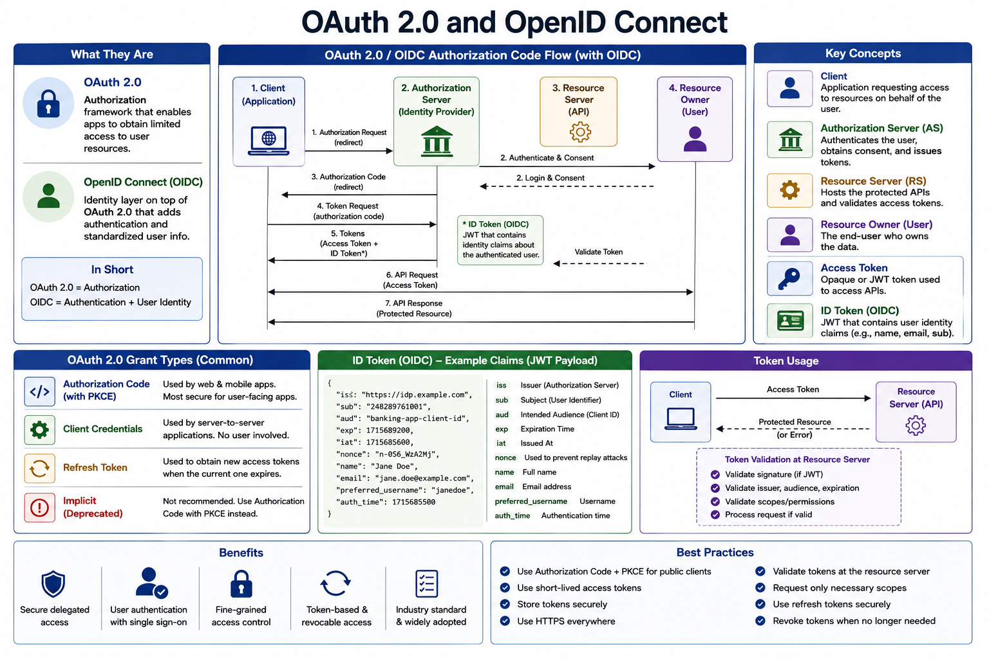
5
© 2026 by Innovation In Software Corporation
Notes:
KEY TALKING POINTS
------------------
- OAuth2 grants access; OIDC proves identity
OAuth2 is an authorization framework: an app obtains limited access to an API without seeing the user's password.
OpenID Connect adds an identity layer on top so the app also learns who signed in.
In one line, OAuth2 answers what the client may call, and OIDC answers who the user is.
Banking platforms need both.
A transfer API needs an access token with transactions.write.
The online-banking shell needs an ID token with a subject, name, and email so it can greet the right person.
- Authorization code flow and the four roles
The centre sequence is the user-facing path.
The client redirects the user to the authorization server.
The user authenticates and consents.
The client receives an authorization code, then exchanges it for tokens.
The access token is sent to the resource server, which validates it and returns the data.
The four roles on the right are the same ones as the previous topic: client, authorization server, resource server, and resource owner.
Lab 3 skips the browser redirect and issues HS256 tokens from a script, but every later production login follows this picture.
- Grant types and ID-token claims
Authorization code with PKCE is the default for web and mobile.
Client credentials is the server-to-server grant with no user present.
Refresh tokens mint new access tokens without another login.
Implicit is deprecated.
The sample ID token payload shows issuer, subject, audience, expiry, and profile claims.
Those claims authenticate the user to the application.
They are not sent as the Authorization header to Account Service or Transaction Service.
APIs consume access tokens, not ID tokens.
- Token usage and validation
The client sends the access token to the resource server.
If the token is a JWT, that server checks the signature, issuer, audience, expiry, and scopes before serving the request.
Lab 3 resource servers do the same with an HS256 secret and classroom scopes.
Production would use the IdP signing keys from OIDC discovery.
Store tokens securely, request only needed scopes, prefer short-lived access tokens, and revoke or drop refresh tokens when the session ends.
A token that is no longer needed is a token that should not still work.
REAL-WORLD EXAMPLES
-------------------
- A retail-banking mobile app uses authorization code with PKCE against the bank IdP.
The app keeps the ID token for the signed-in profile screen and sends only the access token to account and payment APIs.
- A nightly enterprise reconciliation job uses client credentials.
There is no user to redirect.
The job authenticates as itself, receives a short-lived access token, and calls the ledger API.
USE-CASE SCENARIO
-----------------
In production the teller application would follow the authorization-code path, receive an ID token for the teller and an access token with accounts.read and accounts.write, and call Account Service on port 8081.
In class, issue-jwt.py mints the access token directly so the lab can focus on the resource server.
Transaction Service on port 8082 still relays that Bearer token on the account lookup.
Wrong or missing tokens yield 401 or 403.
A down Account Service still yields 503 ACCOUNT_SERVICE_UNAVAILABLE, never ACTIVE.
Day 5 Risk Assessment will accept its own authenticated callers and must not confuse an ID token with an access token.

Slide 7
OPENID CONNECT FUNDAMENTALS · OAUTH ROLES AND AUTHORIZATION FLOWS
📌
TOKENS IN OIDC
✅
KEY BENEFITS
📌
FLOW SELECTION GUIDE
• ID Token (JWT): identity information about the authenticated user (sub, name, email)
• Access Token: used to access protected resources (APIs)
• Refresh Token: used to obtain new access tokens without user interaction
• Single sign-on (SSO) across applications, standardized identity information
• Delegated access with OAuth2, reduces custom authentication implementations
• Web application (server-side) / Mobile / Native: Authorization Code (with PKCE)
• Single-page application (SPA): Authorization Code with PKCE
• First-party/trusted app: Resource Owner Password Credentials
• Microservice / backend-to-backend: Client Credentials
KEY TAKEAWAY The ID token is what OIDC adds: a JWT carrying identity claims like sub, name, and email that OAuth2 alone never provided. • Web and mobile apps use authorization code with PKCE; server-to-server calls use client credentials -- picking the wrong flow weakens security.
6
© 2026 by Innovation In Software Corporation
Notes:
TOPIC 1 OF 2: OpenID Connect Fundamentals
-----------------------------------------
KEY TALKING POINTS
------------------
- TOKENS IN OIDC
OIDC issues up to three tokens because they do three jobs.
The ID token is a JWT meant for the client application.
It carries identity claims such as sub, name, and email so the app knows who signed in.
The access token is what APIs see; it carries authorization, often as scopes.
The refresh token stays with the client and is sent only to the authorization server to mint a new access token when the short one expires.
Mixing them up is the classic error: an API that accepts an ID token is trusting a token that was never issued for that API.
- KEY BENEFITS
One sign-in can cover several banking applications because they trust the same identity provider and the same ID-token claims.
Clients stop inventing their own password tables and session formats.
Delegated access still comes from OAuth2, so the account API can require accounts.read without ever seeing the password.
Standardized claims reduce one-off user-info endpoints.
For this course the benefit is conceptual: Lab 3 ships access tokens only.
Understanding the ID token now prevents participants from stuffing name and email into every API call later.
REAL-WORLD EXAMPLES
-------------------
- After a customer signs in to a bank's online channel, the web shell reads the ID token to show the customer's name, while the account-list XHR sends a separate access token to the Account API.
- Enterprise employees who use SSO to reach Jira, a service portal, and an internal HR app are using OIDC.
Each app reads identity from the ID token and calls its own APIs with an access token.
USE-CASE SCENARIO
-----------------
A future teller UI in front of the AI-Assisted Banking Transaction Risk Platform would keep an ID token to display the teller's name and an access token to call Account Service on port 8081 and Transaction Service on port 8082.
Lab 3 never sends an ID token to those ports.
The classroom HS256 JWT is an access token with scopes.
Transaction Service relays that access token, not a profile document.
If Account Service cannot be reached, the fallback is still 503 ACCOUNT_SERVICE_UNAVAILABLE.
Day 5 Risk Assessment should likewise accept an access token, not an ID token copied from a browser.
TOPIC 2 OF 2: OAuth Roles and Authorization Flows
------------------------------------------
KEY TALKING POINTS
------------------
- FLOW SELECTION GUIDE
The flow is chosen by what the client can keep secret and whether a user is present.
Browser, mobile, and native apps are public clients, so they use authorization code with PKCE.
Single-page apps use the same grant; implicit is retired.
Resource Owner Password Credentials puts the user's password in the client and is only for tightly controlled legacy cases.
Backend jobs and service-to-service calls use client credentials because there is no user to redirect.
Picking password credentials for a mobile banking app, or client credentials for a customer-facing login, weakens the design in opposite directions.
REAL-WORLD EXAMPLES
-------------------
- A retail-banking iOS app uses authorization code with PKCE against the bank IdP.
The app has no client secret in the binary that a jailbreak could extract, and the code verifier stays on the device.
- A platform batch that freezes accounts overnight authenticates with client credentials.
There is no teller in that loop, so a user login flow would be the wrong tool.
USE-CASE SCENARIO
-----------------
Decide the grant for each caller of the capstone.
The future teller web app is authorization code with PKCE.
A scheduled reconcile that only reads transactions would be client credentials with transactions.read.
Lab 3 takes a classroom shortcut: HS256 tokens from issue-jwt.py so participants can practise resource-server checks without standing up an IdP.
Transaction Service on port 8082 still behaves like a confidential hop by relaying the caller's Bearer token to Account Service on port 8081 instead of swapping in a god token.
If that hop fails, 503 ACCOUNT_SERVICE_UNAVAILABLE, never ACTIVE.
Day 5 jobs that call Risk Assessment should pick a grant the same way, not reuse a teller password.

Slide 8
AUTHORIZATION CODE FLOW WITH PKCE · CLIENT CREDENTIALS FLOW · ACCESS TOKENS, ID TOKENS, AND REFRESH TOKENS
📌
HOW PKCE WORKS
✅
WHY PKCE MATTERS
1. Client generates a high-entropy code_verifier
2. Client derives code_challenge = BASE64URL(SHA256(code_verifier))
3. Authorization request includes the code_challenge
4. Token request includes the original code_verifier for validation
• Essential for public clients (SPAs, mobile, native apps) with no client secret
• Now recommended for all OAuth2 clients per RFC 7636
📌
HOW IT WORKS
📌 TOKEN COMPARISON
• Client authenticates with the authorization server using its own credentials
• No user involvement -- the client accesses resources as itself
• Common use: microservice-to-microservice calls, scheduled jobs, background services
FEATURE | ACCESS TOKEN | ID TOKEN | REFRESH TOKEN
Primary use | Access APIs | Authenticate user | Get new tokens
Sent to API | Yes | No | No
Lifetime | Short | Short | Long
KEY TAKEAWAY A stolen authorization code is useless without the original code_verifier -- that's the entire security value PKCE adds for public clients. • Transaction Service authenticates as itself, gets a token, and calls Account Service -- no end-user session involved anywhere. • Access tokens are short-lived and sent to APIs; ID tokens are never sent to APIs; refresh tokens are long-lived and stored securely by the client.
7
© 2026 by Innovation In Software Corporation
Notes:
TOPIC 1 OF 3: Authorization Code Flow with PKCE
------------------------------------------
KEY TALKING POINTS
------------------
- HOW PKCE WORKS
PKCE binds the authorization code to the client that started the login.
The client creates a high-entropy code verifier and sends only a derived code challenge, usually BASE64URL of the SHA-256 hash, with the authorization request.
The authorization server stores that challenge.
When the client later redeems the code, it must present the original verifier.
The server hashes it and compares.
A stolen code, lifted from a redirect on a mobile custom scheme or a shared browser, is useless without the verifier that never left the honest client.
- WHY PKCE MATTERS
Public clients cannot hide a client secret in a mobile binary or a JavaScript bundle, so they used to be the weak point of the authorization-code grant.
PKCE replaces that secret with a per-login proof.
RFC 7636 made it the recommendation for those clients, and current OAuth2 guidance recommends PKCE for confidential clients as well because an extra binding still helps if a code leaks.
For a bank, that is the difference between a copied redirect URL being enough to mint tokens and it being a dead end.
REAL-WORLD EXAMPLES
-------------------
- Mobile-banking apps on iOS and Android use authorization code with PKCE so an attacking app that intercepts the redirect cannot redeem the code.
The honest app still has the verifier it generated.
- Enterprise single-page admin tools moved off implicit flow to authorization code with PKCE plus a small backend for the token exchange, after implicit tokens in the browser hash proved hard to lock down.
USE-CASE SCENARIO
-----------------
When the teller channel in front of the AI-Assisted Banking Transaction Risk Platform is a public client, PKCE is what makes its login safe enough to call Account Service on port 8081 and Transaction Service on port 8082.
Lab 3 does not implement the redirect; it issues HS256 classroom tokens so the resource servers can be taught first.
The scopes on those tokens still matter: a stolen teller token without transactions.write cannot post a transfer, and a relayed Bearer token still cannot invent an ACTIVE account if port 8081 is down.
Day 5 callers should get the same least-privilege treatment even if their grant is different.
TOPIC 2 OF 3: Client Credentials Flow
-------------------------------------
KEY TALKING POINTS
------------------
- HOW IT WORKS
Client credentials is machine login.
The service authenticates to the authorization server with its own client id and secret, receives an access token that represents the service, and calls the API as itself.
There is no browser, no user consent, and no ID token.
Typical callers are scheduled jobs, message processors, and one microservice calling another.
The slide's banking picture is Transaction Service fetching a token and calling Account Service.
Lab 3 does something stricter: it relays the caller's Bearer token so Account Service still sees the original human scopes instead of a service-wide superuser.
REAL-WORLD EXAMPLES
-------------------
- A nightly interest-accrual job authenticates as itself with client credentials and writes to an internal ledger API.
No customer is signed in at 2 a.m., so a user grant would be fiction.
- Enterprise service meshes often combine client credentials or mTLS with narrow scopes so a reporting service can read accounts but cannot post transfers, even when it already has a cluster identity.
USE-CASE SCENARIO
-----------------
Compare the slide with Lab 3 so the room does not implement the wrong trust model.
In a future hardening pass, Transaction Service on port 8082 might present its own client-credentials token plus a forwarded user token.
Today it forwards only the classroom HS256 Bearer token, and Account Service on port 8081 authorizes accounts.read on that user.
Either way the lookup can fail.
The Resilience4j circuit breaker then returns 503 ACCOUNT_SERVICE_UNAVAILABLE and must not mint ACTIVE.
Day 5 Risk Assessment, consuming Kafka as a backend, is a natural client-credentials candidate when it calls other APIs with no user sitting in the loop.
TOPIC 3 OF 3: Access Tokens, ID Tokens, and Refresh Tokens
------------------------------------------
KEY TALKING POINTS
------------------
- TOKEN COMPARISON
Three tokens, three destinations.
The access token is the only one sent to Account Service or Transaction Service; it is short-lived and carries the scopes those APIs enforce.
The ID token authenticates the user to the client application and is never placed in the Authorization header of a banking API.
The refresh token is long-lived, stored by the client, and sent only to the authorization server to obtain new access tokens.
Treating any of them as interchangeable is how APIs accept the wrong credential or how a stolen refresh token becomes a long-lived back door.
REAL-WORLD EXAMPLES
-------------------
- Online banking keeps the refresh token in a secure cookie or OS storage, uses the ID token to render the signed-in header, and attaches only the access token when the statement page calls the transactions API.
- An enterprise SPA that stored an ID token and sent it to every microservice discovered those services could not agree on audience validation.
The fix was to send access tokens to APIs and keep the ID token in the browser app.
USE-CASE SCENARIO
-----------------
On the AI-Assisted Banking Transaction Risk Platform the only token Lab 3 should put on the wire between browser, Transaction Service on port 8082, and Account Service on port 8081 is an access token: an HS256 JWT with accounts.read, accounts.write, transactions.read, or transactions.write.
That token is relayed as Bearer, validated at each hop, and never logged.
There is no ID token in the lab and no refresh token.
If Account Service is unavailable, no token policy can invent ACTIVE; the fallback is 503 ACCOUNT_SERVICE_UNAVAILABLE.
When Day 5 adds Risk Assessment, teach the same split: identity stays in the ID token if a UI exists, and APIs accept access tokens only.

Slide 9
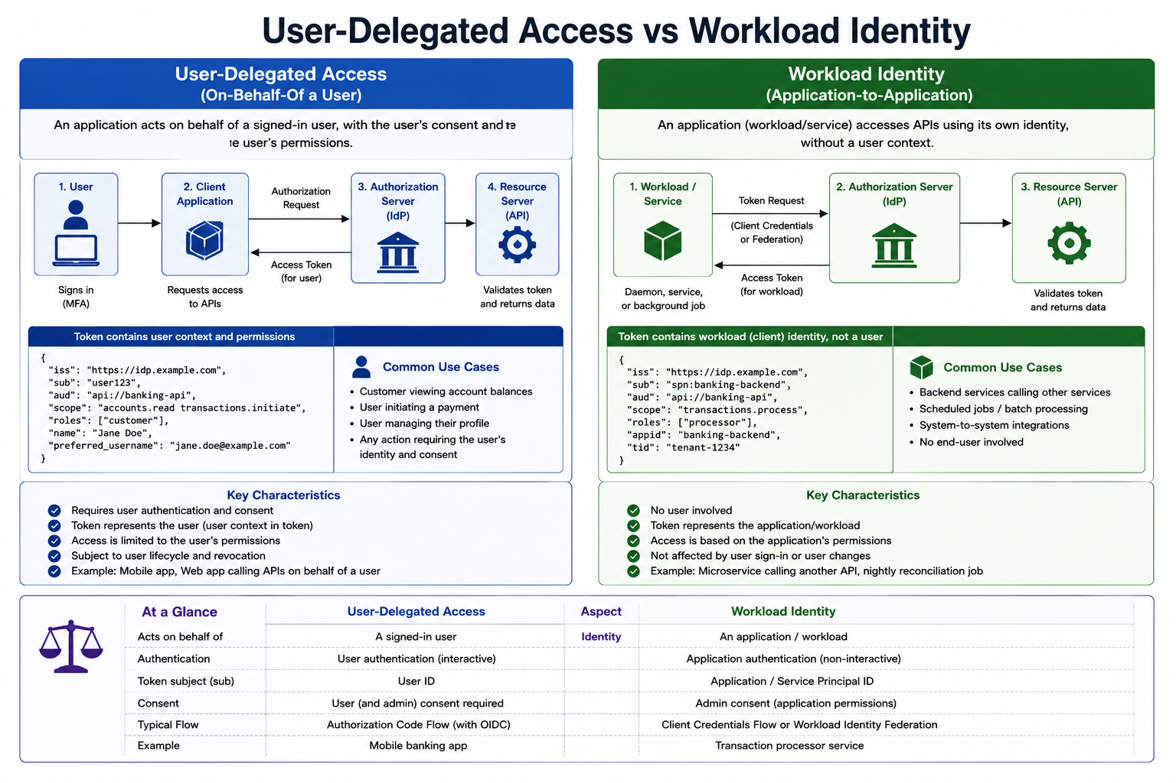
8
© 2026 by Innovation In Software Corporation
Notes:
KEY TALKING POINTS
------------------
- User-Delegated Access flow (left column)
A signed-in person, usually after MFA, lets a client application act for them.
The client sends the user to the authorization server, gets back an access token for that user, and presents it to the API.
The API can then enforce that user's permissions, for example a customer seeing only their own balances.
Correct one detail in the drawing: the arrow from the Authorization Server straight to the Resource Server is misleading.
The IdP never forwards tokens to the API; the client presents the token, and the API only fetches signing keys from the IdP.
- Workload Identity flow (right column)
A daemon, service, or background job authenticates as itself using the client credentials flow or workload identity federation, and receives a token that names the application, not a person.
Access depends on what that application has been granted.
Nobody signs in, so there is no MFA prompt and no consent screen at run time; an administrator grants the permissions up front.
User lifecycle events such as a password reset do not affect it, which is exactly why these identities need tight scopes and careful secret handling.
- Sample token payloads
Compare the two JSON blocks claim by claim.
Both have the same issuer and audience, so the API trusts both.
The difference is the subject: user123 with a name and preferred_username on the left, spn:banking-backend with appid and tid on the right.
Scopes differ too: accounts.read and transactions.initiate for the user, transactions.process for the workload.
The appid and tid claims are Microsoft Entra ID style claims; Keycloak uses different claim names.
In Lab 3 the scopes are accounts.read, accounts.write, transactions.read and transactions.write.
- Key Characteristics and Common Use Cases
The left list ties tokens to a person: authentication and consent are required, access is limited to that user's permissions, and revoking the user revokes access.
Use cases are viewing balances, initiating a payment, and managing a profile.
The right list is the opposite: no user, the token represents the application, and sign-in changes do not matter.
Use cases are backend service calls, scheduled batch jobs such as nightly reconciliation, and system-to-system integrations.
- At a Glance comparison table
The bottom table is the slide in one glance: acts on behalf of a signed-in user versus an application; interactive versus non-interactive authentication; token subject is a user ID versus an application or service principal ID; user consent versus admin consent; Authorization Code flow with OIDC versus Client Credentials or workload identity federation.
Add that for mobile and single-page apps the Authorization Code flow should always use PKCE.
The examples, a mobile banking app and a transaction processor service, map directly to retail banking.
REAL-WORLD EXAMPLES
-------------------
- A customer opens a mobile banking app and checks a checking account balance.
The app holds an access token issued for that customer, so the accounts API can refuse any account ID that does not belong to the token's subject, even if the app is tampered with.
- A nightly statement-generation or reconciliation job runs at 2 a.m.
with no one signed in.
It authenticates with its own client identity and a narrowly scoped token, and its access is audited as the job, not as any employee who happened to deploy it.
USE-CASE SCENARIO
-----------------
In Lab 3, an operations user holding the ops token POSTs a transaction to Transaction Service on port 8082.
Transaction Service must check that the account is ACTIVE, so it calls GET on Account Service.
It does that with the BearerTokenRelayInterceptor, which copies the caller's Authorization header onto the outbound request.
That is the left column: Transaction Service is not a superuser, it borrows the ops user's token, and Account Service sees the same accounts.read scope.
Now imagine a future nightly job in Risk Assessment Service that rescans yesterday's transactions.
No user is present, so relaying is impossible; that job would need the right column, its own client credentials identity.
The lab's optional stretch asks participants to draw exactly that second design.

Slide 10
JSON WEB TOKENS · JWT STRUCTURE AND VALIDATION
📌
HOW A JWT IS USED
✅
KEY POINTS
1. Client logs in with credentials
2. Auth server authenticates and issues a JWT
3. Client sends the JWT in the Authorization header
4. Resource server validates the token and returns a response
• JWTs are stateless -- the server does not store session information
• Never store sensitive data in the payload; always use HTTPS
📌
VALIDATION CHECKS
✅
SYMMETRIC VS. ASYMMETRIC SIGNING
• Signature is valid; token is not expired (exp) or used before its valid time (nbf)
• Audience (aud) is valid; issuer (iss) is trusted; subject (sub) is acceptable
• Symmetric (HMAC): HS256/384/512, shared secret key, faster
• Asymmetric (RSA/ECDSA): RS256/ES256, private key signs, public key verifies -- more secure for distributed systems
KEY TAKEAWAY header.payload.signature -- three Base64Url-encoded parts that let a resource server trust claims without a database lookup. • Split, decode, validate, verify signature, then trust -- five steps stand between an incoming bearer token and an authorized request.
9
© 2026 by Innovation In Software Corporation
Notes:
TOPIC 1 OF 2: JSON Web Tokens
-----------------------------
KEY TALKING POINTS
------------------
- HOW A JWT IS USED
Tighten the first bullet: in OAuth2 and OIDC the user types credentials into the identity provider's login page, not into the client application, and the password grant is discouraged by current OAuth security guidance.
The authorization server then issues a signed access token.
The client sends it as Authorization: Bearer followed by the token on every call, and the resource server validates it locally with the issuer's key before running any business logic.
In Lab 3, tools/issue-jwt.py stands in for the authorization server so nobody has to install an IdP.
- KEY POINTS
Stateless means the service keeps no session: every request carries its own proof, so any pod of Account Service can validate it with no shared session store, which suits scaling on OpenShift.
The trade-off is revocation: a valid JWT keeps working until it expires, which is why access tokens are short-lived.
Base64Url is encoding, not encryption, so anyone holding a token can read its claims; keep account numbers and personal data out.
HTTPS matters because a bearer token works for whoever holds it.
REAL-WORLD EXAMPLES
-------------------
- A card-management API behind a mobile banking app runs many replicas.
Because each request carries a signed JWT, any replica can validate it independently, and a replica restart never logs customers out the way losing an in-memory session would.
- Security reviews at large enterprises regularly find bearer tokens copied into application logs or support tickets.
Since a JWT payload is readable and the token is usable by anyone who holds it, that log line becomes both a data leak and a way in until the token expires.
USE-CASE SCENARIO
-----------------
Run python tools\issue-jwt.py teller from labs/day-03/lab3 and decode the middle part of the token.
Participants see sub lab-teller, iss md287-lab, the scope string accounts.read accounts.write, and iat and exp timestamps, all in plain JSON.
Nobody needed the secret to read it.
Now send it to Account Service on port 8081: the service checks the signature with its configured secret and the expiry, and never touches a database or session to decide who the caller is.
That is statelessness in action, and it is also why the Lab 3 log checklist says never log the Authorization header or JWT claims.
TOPIC 2 OF 2: JWT Structure and Validation
------------------------------------------
KEY TALKING POINTS
------------------
- VALIDATION CHECKS
Order matters: verify the signature first, and pin the expected algorithm so a token cannot talk the server into a weaker one.
Only then trust claim values.
exp and nbf bound the validity window, allowing a small clock skew; Spring's default is 60 seconds.
aud proves the token was minted for this API, so a token for another service cannot be replayed here.
iss must be the trusted IdP.
sub identifies the caller for ownership checks.
Note the Lab 3 decoder checks signature and timestamps only; production adds issuer and audience.
- SYMMETRIC VS. ASYMMETRIC SIGNING
With HS256 one shared secret both signs and verifies, so every service that can verify a token can also forge one.
Lab 3 uses exactly this: md287.jwt.secret sits in both services' application.yml, which is acceptable only in a classroom.
With RS256 or ES256 the IdP keeps the private key and services download public keys from its JWKS endpoint, so a compromised service cannot mint tokens, and keys rotate via the kid header.
Keycloak signs with RS256 by default.
HMAC is faster, but trust boundaries decide, not speed.
REAL-WORLD EXAMPLES
-------------------
- A bank running dozens of Spring Boot APIs trusts one Keycloak realm.
Each API downloads the realm's public keys from JWKS, so when the identity team rotates signing keys, services pick up the new key ID without redeploying or sharing any secret.
- When a bank exposes an API to an external partner, a shared HMAC secret would have to be handed to that partner, letting them forge tokens.
Asymmetric signing avoids that: the partner only ever needs the public key.
USE-CASE SCENARIO
-----------------
A participant in Lab 3 gets 401 even though they pasted a fresh teller token.
Walk the checks with them.
Signature: did Transaction Service and Account Service get the same md287.jwt.secret, and did the paste add a trailing newline?
Timestamps: the lab token lasts 12 hours by default, so yesterday's token has expired.
Once it works, ask what would happen if the Transaction Service config file leaked: an attacker could sign their own teller token and Account Service would accept it.
That is the whole argument for the production design in the lab guide: an identity provider such as Keycloak with RSA keys, where services hold only public keys.

Slide 11
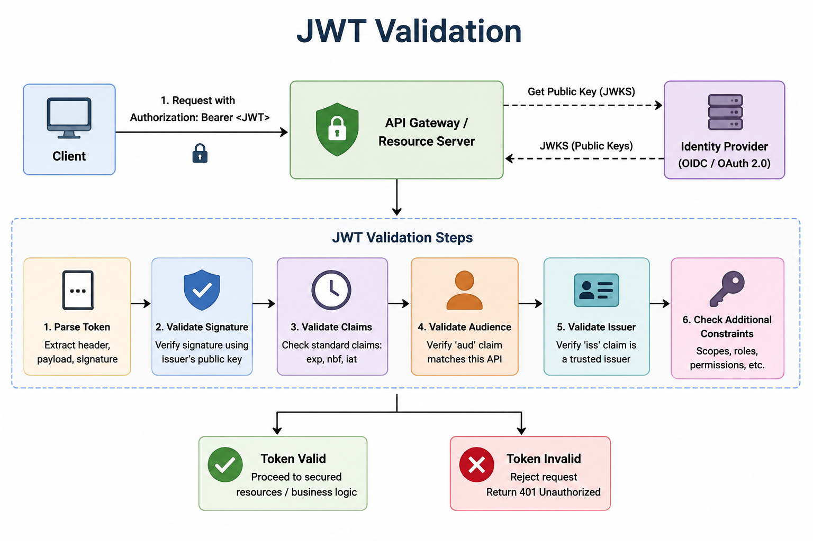
10
© 2026 by Innovation In Software Corporation
Notes:
KEY TALKING POINTS
------------------
- Client and bearer request (top left)
The client attaches the token in the Authorization header using the Bearer scheme.
The padlock icon on the arrow is a reminder that this must travel over TLS, because a bearer token grants access to whoever presents it.
The client does nothing to prove possession beyond holding the string, which is why tokens must not end up in URLs, browser storage that scripts can read, or logs.
In Lab 3 this client is curl.exe with a token from issue-jwt.py.
- API Gateway / Resource Server and JWKS (top center and right)
The validating component can be a gateway, the service itself, or both.
It retrieves the IdP's public signing keys from the JWKS endpoint, found through OIDC discovery.
Clarify that keys are fetched and cached, not requested on every call; libraries typically refresh the cache when a token arrives with an unknown key ID after a rotation.
In Lab 3 there is no JWKS call at all, because HS256 uses a shared secret configured in each service.
- JWT Validation Steps (middle band)
Parse splits header, payload, and signature and rejects anything malformed.
Validate Signature uses the issuer's public key with the expected algorithm.
Validate Claims checks exp and nbf; iat is mostly informational.
Validate Audience confirms aud matches this API.
Validate Issuer confirms iss is trusted.
Check Additional Constraints evaluates scopes, roles, or permissions for the specific endpoint.
Steps one to five answer who the caller is and whether the token is genuine; step six answers whether this caller may do this action.
- Token Valid and Token Invalid outcomes (bottom)
A valid token lets the request continue to the controller.
The Token Invalid box says every failure returns 401, which is not quite right.
Failures in steps one to five mean the caller is not authenticated, so 401 is correct.
A failure in step six means the token is genuine but lacks the needed scope, and that should be 403 Forbidden.
Lab 3 tests both: no token gives 401, the teller token POSTing a transaction gives 403.
REAL-WORLD EXAMPLES
-------------------
- When a bank's identity team rotates Keycloak signing keys, tokens start arriving with a new key ID.
Well-configured resource servers refresh their cached JWKS and keep working; services with keys hard-coded in configuration start rejecting every customer with 401.
- A statements API and a payments API trust the same enterprise IdP.
Without audience validation, a token a customer obtained for downloading statements could be replayed against the payments API, which is exactly what box 4 prevents.
USE-CASE SCENARIO
-----------------
Use the three Lab 3 tokens to walk the pipeline.
A request to Transaction Service with no header never reaches box 1 and gets 401 UNAUTHENTICATED.
The readonly token parses, its HS256 signature verifies, and its 12-hour exp is fine, but when it POSTs to /api/v1/transactions box 6 finds no transactions.write scope, so the correct result is 403.
The ops token passes all six steps and the transaction is created as RECEIVED.
Then ask what happens tomorrow morning with today's ops token: box 3 fails on exp, and the answer is 401 again.
Participants will hit that exact case after an overnight break.

Slide 12
TOKEN EXPIRATION AND ROTATION · SCOPES, ROLES, AND CLAIMS
📌
COMMON TOKEN LIFETIMES
✅
ROTATION BENEFITS AND REUSE DETECTION
• Access token: 5-15 minutes ID token: 15-60 minutes Refresh token: days to weeks (rotate on each use)
• Limits damage if a refresh token is stolen; enables detection of token theft
• Reuse of an old refresh token should invalidate the whole token family and force re-authentication
📌
SCOPES VS. ROLES
🔒
SECURITY NOTE
• Scopes: fine-grained, API-specific, granted to the client application (read:orders, write:orders)
• Roles: broader, organization-specific groupings assigned to the user (USER, MANAGER, ADMIN)
• Claims are readable by anyone with the token -- never put sensitive data in them
• Use roles to assign permissions; use scopes to limit token capabilities
KEY TAKEAWAY If a rotated refresh token is ever reused, that's a signal of theft -- the entire token family should be revoked immediately. • read:orders is a scope granted to the client; MANAGER is a role assigned to the user -- conflating the two weakens authorization design.
11
© 2026 by Innovation In Software Corporation
Notes:
TOPIC 1 OF 2: Token Expiration and Rotation
------------------------------------------
KEY TALKING POINTS
------------------
- COMMON TOKEN LIFETIMES
Present these ranges as common guidance, not a standard; the identity team's policy sets the real values.
Keycloak's default access token lifespan is five minutes, while Microsoft Entra ID defaults are longer, so check your IdP.
Short access tokens shrink the window in which a leaked token is useful, which offsets the fact that stateless JWTs cannot easily be revoked.
ID tokens matter only to the client app and are never sent to APIs.
Refresh tokens live longer, so they need the strongest protection.
Lab 3 tokens last 12 hours purely for classroom convenience.
- ROTATION BENEFITS AND REUSE DETECTION
With rotation, every time the client uses a refresh token it receives a new one and the old one becomes invalid.
If an old token is ever presented again, either an attacker or the legitimate client is using a stolen copy, and the IdP cannot tell which.
The safe response is to revoke the entire family and force the user to sign in again, with MFA.
This pattern is described in the IETF OAuth 2.0 Security Best Current Practice, and Keycloak exposes it as a realm setting to revoke refresh tokens on use.
REAL-WORLD EXAMPLES
-------------------
- A mobile banking app keeps a customer signed in for days using a refresh token while its access tokens expire every few minutes.
If malware copies the refresh token and uses it, the real app's next refresh reuses an old token, the IdP revokes the family, and the customer must log in again with MFA.
- When a branch employee leaves the bank, the identity team disables the account and revokes refresh tokens.
Because access tokens are short-lived, that person's access to internal teller APIs ends within minutes rather than lasting until the end of a long session.
USE-CASE SCENARIO
-----------------
An operations analyst on the Transaction Risk Platform accidentally pastes a curl command, token included, into a team chat.
With a five-minute access token from the production IdP, the exposure window is almost closed by the time anyone notices, and the refresh token never left the analyst's client.
Contrast that with the Lab 3 tokens from issue-jwt.py, which last 12 hours and cannot be revoked at all because there is no IdP tracking them.
That is fine on a laptop in class and unacceptable in production, and it is one more reason the lab guide insists that no log line ever contains a Bearer token.
TOPIC 2 OF 2: Scopes, Roles, and Claims
---------------------------------------
KEY TALKING POINTS
------------------
- SCOPES VS. ROLES
A scope says what this client application may do with this token, such as reading accounts; the user or an admin consents to it.
A role says what this person is in the organization, such as SUPPORT_AGENT or ACCOUNT_MANAGER.
In banking terms, prefer accounts.read and transactions.write over the slide's read:orders.
In Spring Security the scope claim becomes authorities like SCOPE_accounts.read automatically, while Keycloak roles sit in a nested claim and need a custom JwtAuthenticationConverter before hasRole works.
Effective access needs both: the right person and a token scoped for the action.
- SECURITY NOTE
Everything in a JWT payload can be read by the client, a proxy, or anyone who finds the token in a log, so claims should carry identifiers and permissions, never balances, account numbers, or personal details.
Keep role and group lists small too, since tokens travel on every request.
The second bullet is a practical design rule: roles decide what a user is entitled to, and scopes cap what a particular token can exercise.
A powerful user signing in to a low-trust app should still get a narrowly scoped token.
REAL-WORLD EXAMPLES
-------------------
- A customer who can move money in the bank's own app connects a third-party budgeting tool.
The tool receives a token with a read-only accounts scope, so even though the customer's entitlements include transfers, the tool's token cannot initiate one.
- A branch manager holds a manager role, but when signed in through a kiosk-style reporting app the issued token carries only reporting scopes.
The role describes the person; the scopes limit the risk of that particular client.
USE-CASE SCENARIO
-----------------
Lab 3 deliberately uses scopes only.
The teller token carries accounts.read and accounts.write, so it can create, activate, freeze, and close accounts on Account Service, but a POST to /api/v1/transactions returns 403 because transactions.write is missing.
The ops token carries accounts.read, transactions.read, and transactions.write, and the readonly token carries only the two read scopes.
In a real deployment with Keycloak, those three tokens would come from roles: a TELLER role mapped to account scopes, an OPS role mapped to transaction scopes.
The Spring SecurityConfig rules with hasAuthority SCOPE_ values would not change at all.

Slide 13
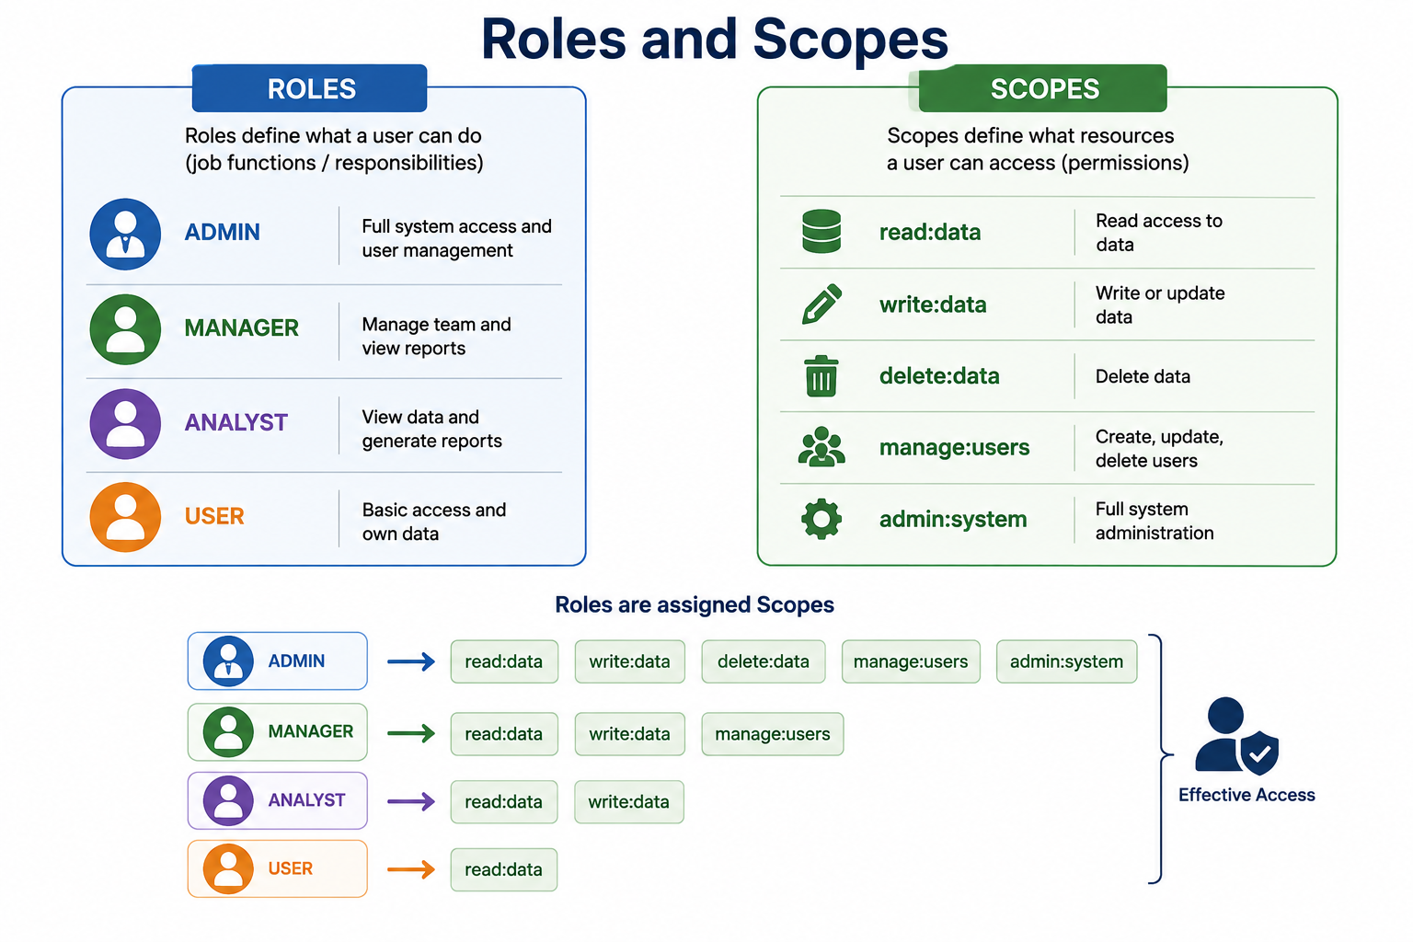
12
© 2026 by Innovation In Software Corporation
Notes:
KEY TALKING POINTS
------------------
- ROLES panel
Roles describe job functions and responsibilities: ADMIN for full system and user management, MANAGER for team management and reports, ANALYST for viewing data and generating reports, USER for basic access to their own data.
In banking the equivalents would be CUSTOMER, TELLER, SUPPORT_AGENT, FRAUD_ANALYST, and a very small ADMIN group.
Roles belong to people and change when someone changes jobs, which is why they are managed in the identity provider rather than in each service.
- SCOPES panel
The scopes read, write, and delete data, manage users, and administer the system.
The panel header says scopes define what resources a user can access; refine that.
Scopes are permissions granted to a client application and carried in a token, limiting what that token can do.
They should be named per API, such as accounts.read or transactions.write, rather than a generic data resource.
Also note delete:data: in the capstone Account Service has no HTTP DELETE, and accounts are closed through a status change instead.
- Roles are assigned Scopes mapping
Each role row expands into scope chips: ADMIN gets all five, MANAGER gets read, write, and manage users, ANALYST gets read and write, USER gets read only.
This is one legitimate implementation, where the IdP includes a scope in the token only if the user holds a matching role.
Point out the inconsistency: ANALYST is described as view data and generate reports, yet it is mapped to write:data.
Least privilege would give an analyst read only.
Also note this mapping blurs the scope versus role distinction from the previous slide, so present it as an IdP configuration choice.
- Effective Access
The bracket on the right merges the chips into Effective Access, meaning what the token actually allows at the API.
That is the useful takeaway: services should authorize on the permissions present in the validated token, not on the user's job title looked up separately.
In Spring Security, effective access is the set of GrantedAuthority values built from the JWT, and rules like hasAuthority SCOPE_accounts.read are evaluated against it.
REAL-WORLD EXAMPLES
-------------------
- In many banks a fraud analyst role grants read access to transaction history and case notes but no ability to change balances or account status, which is exactly the separation of duties the ANALYST row on this diagram fails to show.
- Keycloak can be configured so a client scope is only included in a token for users who hold a particular role, which is how a teller portal can issue account write scopes to tellers but read scopes to everyone else.
USE-CASE SCENARIO
-----------------
Redraw this diagram for the capstone on the whiteboard.
Roles become TELLER, OPS, and READONLY.
Scopes become accounts.read, accounts.write, transactions.read, and transactions.write.
TELLER maps to accounts.read and accounts.write; OPS maps to accounts.read, transactions.read, and transactions.write; READONLY maps to the two read scopes.
That is precisely the table in the Lab 3 guide, with issue-jwt.py playing the IdP that decides which scopes each token carries.
Account Service and Transaction Service never see the role names; they only see scopes and enforce them with hasAuthority rules.

Slide 14
KEYCLOAK ARCHITECTURE · AZURE AD AND MICROSOFT ENTRA ID INTEGRATION · SECURING SPRING BOOT WITH SPRING SECURITY
📌
KEYCLOAK DATA MODEL
✅
KEY COMPONENTS
📌
WHY IT MATTERS
• Realm: top-level container for tenants or domains (e.g., 'banking')
• Client: an application or service that uses Keycloak (customer-service, account-service)
• Users, Roles, Groups: identity, permissions, and logical groupings
• Authentication services, authorization services, user federation, token services
• Supports OAuth2, OpenID Connect, and SAML 2.0
• Single sign-on, enterprise user identities, group-based access, conditional access
• App registrations define scopes, app roles, redirect URIs, and secrets/certificates
✅
SPRING BOOT CONFIGURATION
📌
HIGH-LEVEL SECURITY FLOW
✅
AUTHORIZATION STRATEGIES
• spring.security.oauth2.resourceserver.jwt.issuer-uri: https://login.microsoftonline.com/{tenant-id}/v2.0
• Validate issuer, audience, and roles/groups claims from the ID and access tokens
• User sends request -> filter chain intercepts -> authenticate -> authorize -> access granted/denied
• Roles (hasRole), authorities (hasAuthority), method security (@PreAuthorize), URL security
• Disable CSRF for stateless APIs; use stateless session creation policy
KEY TAKEAWAY Realms, clients, users, roles, and groups form Keycloak's data model -- the same building blocks behind every OAuth2/OIDC deployment. • Lecture only — labs use HMAC JWT via issue-jwt.py; Entra ID / Keycloak are not a participant install. issuer-uri and jwk-set-uri configuration in Spring Boot are all it takes to validate tokens issued by an enterprise tenant. • requestMatchers rules plus oauth2ResourceServer().jwt() turn a Spring Boot service into a token-validating, role-aware protected API in a few lines.
13
© 2026 by Innovation In Software Corporation
Notes:
TOPIC 1 OF 3: Keycloak Architecture
-----------------------------------
KEY TALKING POINTS
------------------
- KEYCLOAK DATA MODEL
A realm is an isolated security domain with its own users, clients, roles, and signing keys; its tokens carry an issuer URL ending in realms and the realm name, such as banking.
A client is any application that asks Keycloak for tokens or validates them; for this capstone think account-service and transaction-service rather than the slide's customer-service.
Users are identities, roles are permissions at realm or client level, and groups bundle users so roles can be assigned once to a group such as branch tellers.
- KEY COMPONENTS
Authentication services handle login, MFA, and password policy.
Authorization services offer optional fine-grained policies.
User federation connects existing directories such as LDAP or Active Directory so users are not copied.
Token services issue access, ID, and refresh tokens and publish the JWKS keys that resource servers use.
OAuth2 and OIDC matter for APIs; SAML 2.0 matters for older enterprise apps.
Red Hat offers a supported Red Hat build of Keycloak that runs on OpenShift, which is why it fits this course's stack.
REAL-WORLD EXAMPLES
-------------------
- An enterprise running internal banking tools on OpenShift can deploy the Red Hat build of Keycloak, federate employee identities from Active Directory, and give each microservice its own client, so no service ever stores employee passwords.
- A bank that acquires another institution can place the acquired customers in a separate realm with its own login branding and policies while the migration is planned, keeping identities isolated from the existing customer base.
USE-CASE SCENARIO
-----------------
Ask participants what would change if the Transaction Risk Platform moved from issue-jwt.py to Keycloak.
The identity team creates a banking realm, clients for account-service and transaction-service, client scopes named accounts.read, accounts.write, transactions.read, and transactions.write, and roles for tellers and operations staff.
In each service, the custom HS256 JwtDecoder bean and md287.jwt.secret go away, replaced by an issuer-uri pointing at the realm.
The SecurityConfig rules that check SCOPE_ authorities stay exactly as written in Lab 3.
The lab guide's optional stretch says the same thing: Keycloak would replace issue-jwt.py in an environment with an IdP.
TOPIC 2 OF 3: Azure AD and Microsoft Entra ID Integration
------------------------------------------
KEY TALKING POINTS
------------------
- WHY IT MATTERS
Many banks already run workforce identity on Microsoft Entra ID, so an internal API may have to trust Entra tokens.
Employees get single sign-on and group-based access, and conditional access policies such as MFA or a compliant device are enforced at sign-in by identity administrators, not in your service.
The API is represented by an app registration that exposes delegated scopes like api://account-service/accounts.read and app roles for application permissions.
Redirect URIs belong to client apps.
Prefer certificates or managed identities over long-lived client secrets.
- SPRING BOOT CONFIGURATION
The issuer-uri shown suits version 2.0 access tokens.
If the API registration still issues version 1 tokens, the issuer is the sts.windows.net form and validation fails with an issuer mismatch, a common first-day problem.
Correct the second bullet: an API validates access tokens only; ID tokens are for the client and should never be sent to APIs.
Also, issuer-uri alone does not check audience, so configure an audience check, either the jwt audiences property in recent Spring Boot 3 releases or a custom validator, plus mapping for roles or groups claims.
REAL-WORLD EXAMPLES
-------------------
- An internal fraud case-management API lets employees in an Entra group for fraud analysts view flagged transactions.
Conditional access requires MFA from a managed device, so the API receives only tokens from sessions that already met the bank's sign-in policy.
- A team deploys a Spring Boot API that trusts the corporate tenant but forgets the audience check.
Any token from that tenant, including ones issued for unrelated internal apps, is then accepted, a misconfiguration an audience validator prevents.
USE-CASE SCENARIO
-----------------
Imagine the bank asks that Transaction Service accept staff tokens from its Entra tenant.
The identity team registers the API and exposes transactions.read and transactions.write as scopes; the operations portal registers as a client that requests them.
In Transaction Service, the lab's HS256 decoder is replaced with issuer-uri for the tenant, an audience check for the API's application ID URI, and nothing else.
Because Entra delivers delegated scopes in the scp claim rather than scope, Spring Boot still maps them to SCOPE_ authorities, so the hasAuthority SCOPE_transactions.write rule from Lab 3 keeps working.
This is lecture only, but it shows how little of the lab code is IdP-specific.
TOPIC 3 OF 3: Securing Spring Boot with Spring Security
------------------------------------------
KEY TALKING POINTS
------------------
- HIGH-LEVEL SECURITY FLOW
Spring Security is a chain of servlet filters that runs before your controller.
For a resource server, the bearer token filter extracts the Authorization header, the JwtDecoder validates the token, and an Authentication object is placed in the security context.
The authorization filter then checks the matching request rule.
Failures take two different exits: missing or bad tokens go to the authentication entry point for 401, and insufficient authority goes to the access denied handler for 403.
Lab 3 plugs JSON error bodies into both exits via SecurityJsonHandlers.
- AUTHORIZATION STRATEGIES
hasRole('ADMIN') checks for an authority named ROLE_ADMIN, while hasAuthority checks the exact string, which is why Lab 3 uses hasAuthority('SCOPE_accounts.read').
URL rules are evaluated in order, first match wins, and anyRequest().authenticated() must come last.
Method security with @PreAuthorize needs @EnableMethodSecurity.
For bearer-token APIs, CSRF protection is unnecessary and a stateless session policy stops Spring creating HTTP sessions; the Lab 3 solution sets both.
Note the takeaway's chained oauth2ResourceServer().jwt() form is deprecated; use the lambda style the lab uses.
REAL-WORLD EXAMPLES
-------------------
- A bank's account-inquiry API permits only the health endpoint anonymously, requires an accounts read authority for every GET, and requires a write authority for any change.
A single mis-ordered rule that permits everything would silently expose balances, which is why security rules get their own tests.
- Operations teams rely on a public health endpoint for OpenShift probes while every business endpoint requires a token.
Keeping those two lists explicit in the filter chain avoids the common incident of an entire actuator surface being left open.
USE-CASE SCENARIO
-----------------
Show the Lab 3 solution SecurityConfig for Account Service.
Health, info, and Swagger paths are permitted.
GET on any path under /api/v1/accounts requires SCOPE_accounts.read.
POST to create, PATCH, and the activate, freeze, and close actions require SCOPE_accounts.write.
Everything else requires authentication.
CSRF is disabled and sessions are stateless.
Then play it out: curl.exe to /actuator/health with no token returns 200, a GET on accounts with no token returns 401, the readonly token trying to freeze an account returns 403, and the teller token freezing it succeeds.
Participants will write this same rule set in Lab 3 Step 2.

Slide 15
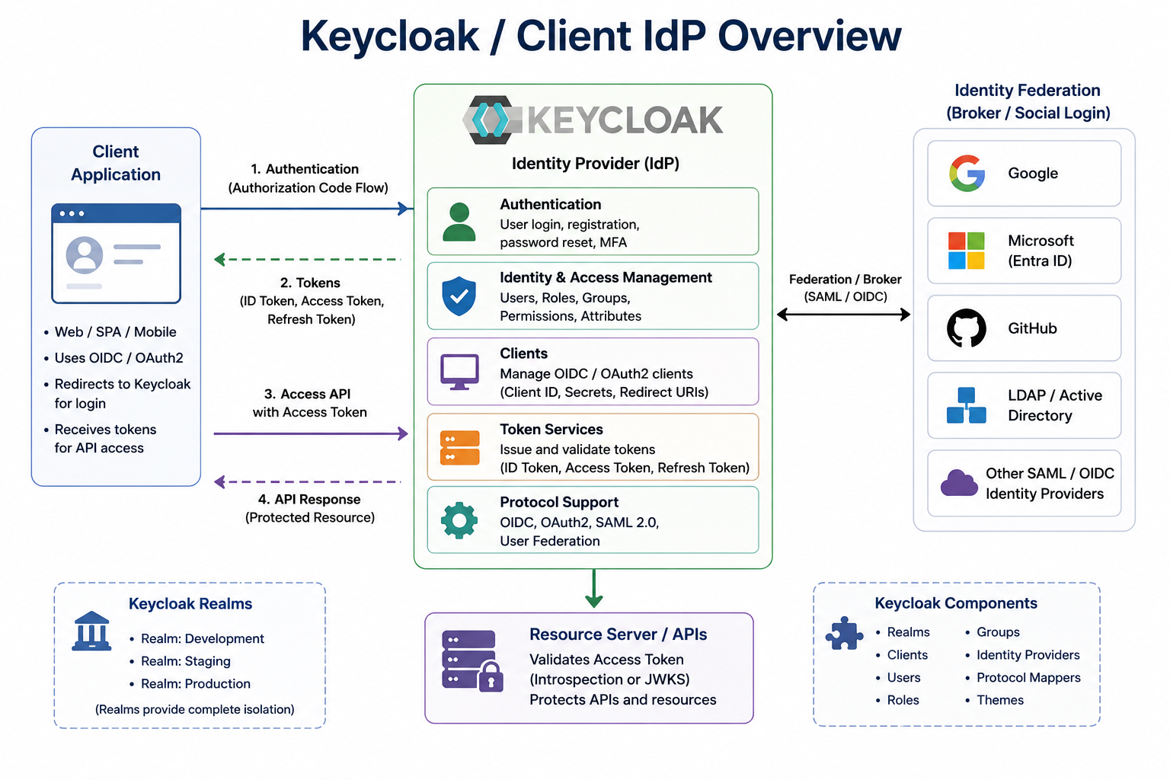
14
© 2026 by Innovation In Software Corporation
Notes:
KEY TALKING POINTS
------------------
- Client Application and numbered flow (left)
The client, a web, single-page, or mobile app, redirects the user to Keycloak with the Authorization Code flow in arrow 1, and should use PKCE for single-page and mobile apps.
Arrow 2 returns ID, access, and refresh tokens.
Correct arrows 3 and 4: they are drawn into and out of the Keycloak box, but the client calls the Resource Server with the access token and gets the API response from it.
Keycloak is not a proxy for API traffic; it only issues tokens and publishes keys.
- Keycloak Identity Provider capabilities (center)
Five cards describe what Keycloak does.
Authentication covers login, registration, password reset, and MFA.
Identity and access management stores users, roles, groups, permissions, and attributes.
Clients registers each application with its client ID, credentials, and redirect URIs.
Token services issue and validate ID, access, and refresh tokens.
Protocol support covers OIDC, OAuth2, SAML 2.0, and user federation.
Tie it back: this is the component that issue-jwt.py imitates in Lab 3.
- Identity Federation (right)
Keycloak can broker sign-in to external providers so users keep existing credentials: social logins such as Google or GitHub, enterprise Microsoft Entra ID, and any other SAML or OIDC provider.
Clarify LDAP and Active Directory: Keycloak connects to those through user federation, reading directory users, rather than through SAML or OIDC brokering as the single arrow label suggests.
For bank employees, federation with the corporate directory is the normal choice; social login is for consumer scenarios.
- Resource Server / APIs (bottom center)
The resource server validates the access token and protects APIs, either locally using the realm's JWKS public keys or by calling Keycloak's token introspection endpoint.
Local JWT validation is faster and is what Spring Security's jwt support does; introspection lets the IdP report revocation immediately at the cost of a network call per request, or a cache.
The green arrow from Keycloak means trust and keys, not request forwarding.
- Keycloak Realms and Keycloak Components (bottom corners)
The left box shows realms named Development, Staging, and Production, and says realms provide complete isolation.
Realms do isolate users, clients, and keys, but they share one server and its administrators, so production identity usually runs on a separate Keycloak deployment rather than as a realm beside development.
The right box lists Keycloak's building blocks: realms, clients, users, roles, groups, identity providers, protocol mappers that shape token claims, and themes for login page branding.
REAL-WORLD EXAMPLES
-------------------
- An enterprise deploys the Red Hat build of Keycloak for internal tools, federates employees from its Active Directory, and brokers a subsidiary's users from that subsidiary's own Entra ID tenant, so every internal API trusts one issuer.
- A consumer-facing brand offers Google sign-in for a rewards portal through Keycloak's identity brokering, while its core banking apps require the bank's own credentials with MFA, both managed from the same identity platform with different realms and policies.
USE-CASE SCENARIO
-----------------
Close the module by mapping this picture onto the capstone.
Today, in Lab 3, the Client Application is a participant with curl.exe, Keycloak is replaced by tools/issue-jwt.py, and the Resource Servers are Account Service and Transaction Service validating HS256 tokens.
In a production rollout, operations staff sign in to an operations dashboard through Keycloak federated with the bank's directory, the dashboard receives an access token with transactions.write, and calls Transaction Service, which relays the token to Account Service.
Both services validate against the realm's JWKS keys through issuer-uri.
The SecurityConfig scope rules written in Lab 3 are unchanged; only where tokens come from and how keys are trusted differ.

Slide 16
CONFIGURING AN OAUTH2 RESOURCE SERVER
issuer-uri enables OIDC discovery, automatically fetching the JWKS endpoint used to verify every incoming token's signature.
📌
SETUP STEPS
✅
RESPONSE BEHAVIOR
1. Add the spring-boot-starter-oauth2-resource-server dependency
2. Configure spring.security.oauth2.resourceserver.jwt.issuer-uri
3. Configure the security filter chain with authorizeHttpRequests and oauth2ResourceServer(oauth2 -> oauth2.jwt())
4. Call the API with Authorization: Bearer <access_token>
• Invalid or unauthorized tokens return 401 or 403 automatically
KEY TAKEAWAY issuer-uri enables OIDC discovery, automatically fetching the JWKS endpoint used to verify every incoming token's signature.
15
© 2026 by Innovation In Software Corporation
Notes:
KEY TALKING POINTS
------------------
- SETUP STEPS
The starter brings in Spring Security, resource server support, and the Nimbus JOSE library.
issuer-uri lets Spring Boot read the IdP's discovery document, locate the JWKS endpoint, and also validate the iss claim; jwk-set-uri alone skips discovery and issuer checking.
The filter chain states which paths need which authority.
Lab 3 differs on purpose: it defines its own JwtDecoder bean using HS256 and md287.jwt.secret, and a custom decoder bean replaces the issuer-uri auto-configuration.
Callers then send Authorization: Bearer followed by the token, with curl.exe in the lab.
- RESPONSE BEHAVIOR
Be precise about automatically.
A missing, malformed, badly signed, or expired token gives 401 with a WWW-Authenticate: Bearer header.
A valid token lacking the required authority gives 403.
Spring's default responses have empty bodies, so Lab 3 adds JSON bodies such as UNAUTHENTICATED through SecurityJsonHandlers.
The response you must never see is a silent 200 for a token with the wrong scope; that means a rule is missing or a path is accidentally permitted, and the lab's security tests exist to catch it.
REAL-WORLD EXAMPLES
-------------------
- A team adds the resource server starter and issuer-uri for the bank's IdP, but the service cannot reach the IdP's discovery URL from its OpenShift namespace because of an egress policy.
Token validation fails until networking allows it, a good reminder that the IdP is a runtime dependency.
- An API returning 403 with an empty body confuses a mobile team for days.
Adding a consistent JSON error body for 401 and 403 while still revealing nothing sensitive makes client-side handling and support tickets much clearer.
USE-CASE SCENARIO
-----------------
Walk Lab 3 Step 2 as the live example.
Before the change, creating an account on port 8081 without a token returns 201, proving the starter is open.
After replacing the filter chain and restarting, the same request returns 401 UNAUTHENTICATED, while /actuator/health still returns 200 so operators can probe it.
Then issue a teller token with python tools\issue-jwt.py teller, store it in a PowerShell variable, and repeat the create request with the Authorization header: 201 again.
Finish by using the readonly token on the same request to show 403.
The lab starts services open on purpose, so a later 401 means security works, not that PostgreSQL is down.

Slide 17
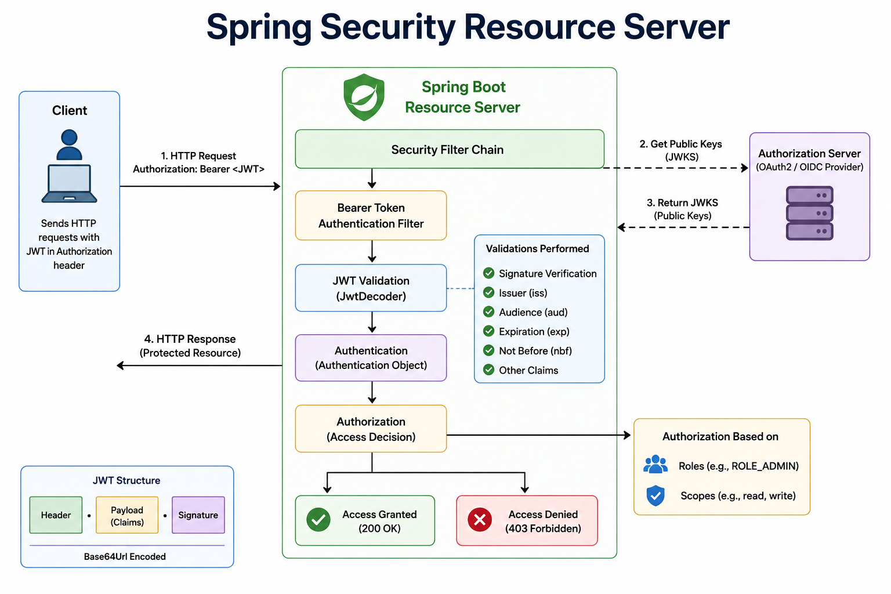
16
© 2026 by Innovation In Software Corporation
Notes:
KEY TALKING POINTS
------------------
- Client and request/response arrows (left)
Arrow 1 is the client's HTTP request with Authorization: Bearer and the JWT; arrow 4 is the response carrying the protected resource.
Everything in between happens inside the service before any controller or business code runs.
In Lab 3 the client is curl.exe against port 8081 or 8082, and in the token relay step Transaction Service itself becomes the client of Account Service, forwarding the same header.
- Spring Boot Resource Server pipeline (center)
The Security Filter Chain hands the request to the Bearer Token Authentication Filter, which extracts the token.
JwtDecoder validates it.
On success Spring builds an Authentication object holding the subject and authorities and stores it in the security context.
The Authorization step then applies the matching requestMatchers rule or @PreAuthorize expression.
The diagram shows only the 403 exit.
Add the missing one: if JwtDecoder rejects the token, the request never reaches authorization and returns 401.
- Validations Performed panel
The checklist names signature, issuer, audience, expiration, not before, and other claims.
Clarify what Spring does by default: with issuer-uri it checks signature, issuer, exp, and nbf; audience is checked only if you configure it.
The Lab 3 HS256 decoder checks signature, exp, and nbf, since lab tokens carry no audience.
Treat the panel as the production target list rather than a promise of default behavior.
- Authorization Server and JWKS (right)
Arrows 2 and 3 show the service getting public keys from the OAuth2 or OIDC provider.
The arrows start at the filter chain, but in practice JwtDecoder fetches the key set and caches it, refreshing on key rotation, so this is not a network call per request.
In Lab 3 these arrows do not exist because the shared HS256 secret lives in configuration.
- Authorization Based on and JWT Structure panels
The lower right panel says access decisions use roles such as ROLE_ADMIN and scopes such as read and write.
By default Spring turns the scope claim into authorities such as SCOPE_read; ROLE_ authorities from JWT claims need a custom converter.
The lower left panel recalls the token format: header, payload of claims, and signature, each Base64Url encoded and joined by dots, readable by anyone.
REAL-WORLD EXAMPLES
-------------------
- A bank's payments API logs a burst of 401 responses right after an identity team key rotation.
Knowing the pipeline, engineers check whether JwtDecoder refreshed its cached JWKS rather than hunting through controller code, which never ran.
- A support team configures hasRole checks on an internal API without a claim converter, so every staff request returns 403.
Understanding that Spring only maps the scope claim by default turns a day of confusion into a small configuration fix.
USE-CASE SCENARIO
-----------------
Trace one Lab 3 request through this picture.
The ops user POSTs a transaction to port 8082 with a Bearer token and X-Correlation-Id lab3-demo.
The bearer filter extracts the token, the HS256 JwtDecoder verifies signature and expiry, and Spring builds an Authentication with SCOPE_transactions.write among its authorities.
The POST rule passes, so the controller runs and calls Account Service.
The relay interceptor copies the Authorization header, and the same pipeline runs again inside Account Service, where SCOPE_accounts.read allows the GET.
Both services log accountId, status, and the correlation id, but neither ever logs the token or its claims.

Slide 18
METHOD-LEVEL AUTHORIZATION · ROLE-BASED ACCESS CONTROL · ATTRIBUTE-BASED ACCESS CONTROL
📌
COMMON ANNOTATIONS
✅
BEST PRACTICES
📌
HOW RBAC WORKS
• @PreAuthorize: evaluates before method execution, blocks access if the expression is false
• @PostAuthorize: evaluates after execution, useful for validating the result
• @PreFilter / @PostFilter: filter collection arguments or results
• Use method security for business rules that can't be enforced by URLs alone
• Always combine with authentication and URL-level security for true defense in depth
• Define roles that represent job functions (CUSTOMER, SUPPORT_AGENT, ACCOUNT_MANAGER, ADMIN)
• Assign permissions to each role, then assign roles to users
• Authorization checks a user's role rather than individual permissions
📌
ABAC EVALUATES MULTIPLE ATTRIBUTES
✅
WHEN TO USE ABAC OVER RBAC
• Subject attributes: role, department, clearance level
• Resource attributes: sensitivity, owner, classification
• Environment attributes: time, location, device, risk score
• When access decisions depend on context, not just a static role
• More flexible and fine-grained, at the cost of more complex policy design
KEY TAKEAWAY hasAuthority('order:read') or #id == authentication.name lets one method enforce both a permission check and object ownership together. • A SUPPORT_AGENT role bundles exactly the permissions that job needs; adding a new agent means assigning one role, not a dozen permissions. • A policy like 'branch managers can approve loans under $50k for their own branch' needs ABAC -- RBAC alone can't express that condition.
17
© 2026 by Innovation In Software Corporation
Notes:
TOPIC 1 OF 3: Method-Level Authorization
----------------------------------------
KEY TALKING POINTS
------------------
- COMMON ANNOTATIONS
Method security requires @EnableMethodSecurity.
@PreAuthorize evaluates an expression before the method, for example hasAuthority('SCOPE_accounts.write') on a freeze method.
@PostAuthorize runs the method first and checks the returned object, so never use it on methods with side effects: a transfer would execute and then be denied.
@PreFilter and @PostFilter filter collections in memory, which is inefficient for large result sets; filtering in the query is usually better.
These annotations work through Spring proxies, so a call from one method to another in the same class skips the check.
- BEST PRACTICES
URL rules answer whether a caller may use this kind of endpoint; method rules answer whether they may act on this specific object.
Broken object level authorization, a user changing an ID in the URL to read someone else's data, heads the OWASP API Security Top 10, and URL rules cannot stop it.
A banking version of the takeaway is hasAuthority('SCOPE_accounts.read') and #customerId == authentication.name, where authentication.name is the JWT sub by default.
Keep URL rules too: defense in depth means one missing annotation does not open an endpoint.
REAL-WORLD EXAMPLES
-------------------
- A customer signed in to online banking edits the account ID in a statement download URL.
The URL rule passes because the customer is authenticated with the right scope, but a method-level ownership check compares the account's owner with the token subject and denies the request.
- A loan servicing API lets any authenticated officer call its update method, but @PreAuthorize adds a condition that the officer is assigned to that loan, enforcing a business rule the URL pattern alone could never express.
USE-CASE SCENARIO
-----------------
Lab 3 enforces scopes with URL rules only, which is right for the time available.
Ask what is still missing for real customers.
Today any token with accounts.read can GET any accountId on Account Service.
If customers called it directly, a method such as getAccount would need a check that the account's owner matches the authenticated subject, either with @PreAuthorize referencing a bean or an explicit ownership check in the service.
Transaction Service would need the same before accepting a transaction against an account.
Frame it as the next hardening step after the lab, not something to add during it.
TOPIC 2 OF 3: Role-Based Access Control
---------------------------------------
KEY TALKING POINTS
------------------
- HOW RBAC WORKS
RBAC puts a layer between people and permissions.
The bank defines roles around real jobs, attaches permissions to each role once, and then manages people by adding or removing roles.
That makes onboarding, transfers, and audits simple: an auditor asks who holds ACCOUNT_MANAGER, not who has each of forty permissions.
The weakness is role explosion: when access starts depending on branch, amount, or time, teams create ever more roles, and that is the point where attribute-based rules become better.
Keep ADMIN tiny and reviewed.
REAL-WORLD EXAMPLES
-------------------
- When a contact-center agent joins a card-services team, the identity team adds one SUPPORT_AGENT role.
The agent can view customer summaries and recent transactions but cannot change credentials or limits, and when the agent leaves, removing the role removes all of it at once.
- Periodic access reviews in regulated banks are far easier with RBAC: managers certify that each person still needs their roles, rather than reviewing long lists of individual permissions for every employee.
USE-CASE SCENARIO
-----------------
Picture the operations team using the Transaction Risk Platform.
Instead of granting each new hire individual scopes, the identity provider defines three roles that mirror the Lab 3 tokens: TELLER for account opening and status changes, OPS for submitting and reviewing transactions, and READONLY for auditors.
A new auditor gets the READONLY role and immediately receives tokens with only the read scopes.
Account Service and Transaction Service do not change, because they authorize on the scopes those roles produce.
When the auditor moves teams, one role removal cuts off access across both services.
TOPIC 3 OF 3: Attribute-Based Access Control
------------------------------------------
KEY TALKING POINTS
------------------
- ABAC EVALUATES MULTIPLE ATTRIBUTES
ABAC decides by combining facts about the caller, the thing being accessed, and the situation.
Subject attributes come from the token or directory, such as role, department, or branch.
Resource attributes come from the data, such as the account owner or a restricted-account flag.
Environment attributes come from the request context, such as time, location, device posture, or a risk score.
The risk score is a natural link to this capstone: the Risk Assessment Service built on Day 5 produces exactly that kind of signal.
- WHEN TO USE ABAC OVER RBAC
Use ABAC when the same role should get different answers depending on context, such as an amount threshold, own branch only, or business hours.
The price is policy complexity: rules must be written, tested, versioned, and explained to auditors.
In Spring you can start small with @PreAuthorize calling a policy bean method that receives the authentication and the object.
Larger organizations often centralize policies in an engine such as Open Policy Agent or Keycloak Authorization Services.
Most real systems combine both: RBAC for coarse access, ABAC for sensitive decisions.
REAL-WORLD EXAMPLES
-------------------
- A loan approval rule lets branch managers approve loans below a set amount for their own branch only.
Role, loan amount, and branch are three attributes, and expressing the combination as pure roles would need a separate role for every branch and threshold.
- Wire transfers above a threshold initiated from an unrecognized device or unusual location are held for step-up verification.
The caller's role is unchanged; the environment attributes change the decision.
USE-CASE SCENARIO
-----------------
Extend the capstone in discussion.
The ops token allows POST to /api/v1/transactions, which is pure RBAC by scope.
Now the business adds a rule: transactions above a set amount may be submitted by operations staff only during business hours, and only if the Risk Assessment Service score is below a threshold; otherwise they are held for review.
None of that fits into a scope.
A policy method would take the authenticated caller, the transaction amount, the current time, and the risk score, and return allow, deny, or hold.
Stress that Lab 3 does not build this; it shows where the platform's security naturally grows next.

Slide 19
SERVICE-TO-SERVICE AUTHENTICATION · API GATEWAY SECURITY · CROSS-ORIGIN RESOURCE SHARING
📌
SERVICE-TO-SERVICE AUTH OPTIONS
📌
GATEWAY SECURITY RESPONSIBILITIES
• OAuth2 client credentials flow -- each service authenticates with its own client ID/secret
• Mutual TLS (mTLS) -- both sides present certificates to verify identity
• Service accounts and platform-issued identities (e.g., OpenShift service accounts)
• Token validation and authentication before requests reach any backend service
• Rate limiting, IP allowlisting, and WAF-style request filtering
• TLS termination and consistent security headers across every API
📌
WHAT CORS CONTROLS
✅
BEST PRACTICE
• Which browser origins may call the API, which HTTP methods, and which headers
• The browser enforces this, not the server -- but the server declares the policy
• Restrict allowed origins explicitly in production; never wildcard when credentials are involved
KEY TAKEAWAY OAuth2 client credentials, mTLS, and service accounts each give one service a verifiable identity when calling another. • Centralizing security at the gateway means individual services don't each have to reimplement the same authentication and throttling logic. • Allowing every origin (*) in production is rarely safe -- CORS should be scoped to the specific frontend domains that legitimately call the API.
18
© 2026 by Innovation In Software Corporation
Notes:
TOPIC 1 OF 3: Service-to-Service Authentication
------------------------------------------
KEY TALKING POINTS
------------------
- SERVICE-TO-SERVICE AUTH OPTIONS
Client credentials gives each service its own IdP client and narrowly scoped token, so the receiving API can tell which service is calling and what it may do; the secret must live in an OpenShift Secret or vault, never in Git, and certificate-based client authentication is stronger.
mTLS proves which workload is on each end of a connection at the transport layer.
OpenShift service accounts give every pod a platform identity with a projected token that can be federated with an IdP, avoiding stored secrets.
Lab 3 uses none of these; it relays the user's token instead.
REAL-WORLD EXAMPLES
-------------------
- A payments service calls a sanctions-screening service for every outgoing wire.
It authenticates with its own client credentials and a screening-only scope, so the screening API can reject any other internal caller, and audit logs name the payments service rather than an anonymous IP address.
- Batch jobs running in an OpenShift namespace use their service account identity to obtain tokens, which removes long-lived client secrets from configuration files and lets platform teams revoke a job's access by changing its service account binding.
USE-CASE SCENARIO
-----------------
Contrast two calls in the capstone.
In Lab 3, Transaction Service calls Account Service while handling a user request, so it relays the ops user's token, keeping the user's identity for audit and limiting Transaction Service to what that user may do.
Now consider Risk Assessment Service on Day 5 reacting to a transaction event from Kafka.
There is no user request and no token to relay.
If it needed account details from Account Service, it would need its own identity: a client credentials token with only accounts.read, or a service account identity federated with the IdP, ideally over mTLS.
Ask the room which they would choose and what they would log.
TOPIC 2 OF 3: API Gateway Security
----------------------------------
KEY TALKING POINTS
------------------
- GATEWAY SECURITY RESPONSIBILITIES
A gateway gives one place to reject bad traffic early: invalid tokens, abusive request rates on login or payment endpoints, disallowed source IPs, and obviously malicious payloads.
It also terminates TLS and adds consistent headers across every API.
Red Hat 3scale API Management and Spring Cloud Gateway are examples, while an OpenShift Route mainly handles TLS and routing.
Add the caution: a gateway complements service-level security, it does not replace it.
Services should still validate tokens and never trust a user ID header set upstream, because internal callers can bypass the gateway.
REAL-WORLD EXAMPLES
-------------------
- A bank publishes open banking APIs to third parties through a gateway that enforces per-partner rate limits and token validation.
A misbehaving partner integration is throttled at the edge before it can overload core account systems.
- A credential-stuffing attack against a retail login endpoint is slowed at the gateway with request-rate limits by IP and username, while the backend authentication service still enforces its own lockout rules as a second layer.
USE-CASE SCENARIO
-----------------
Suppose the bank places a gateway in front of the Transaction Risk Platform on OpenShift.
It terminates TLS, rate-limits POST /api/v1/transactions per client, and rejects requests without a valid bearer token.
A developer then suggests removing the Lab 3 SecurityConfig from Account Service because the gateway already checks tokens.
Walk through why that is wrong: Transaction Service calls Account Service directly inside the cluster, never passing the gateway, and a compromised pod could do the same.
The Lab 3 rule stands: each resource server validates its own tokens, and the gateway is an additional layer, not a substitute.
TOPIC 3 OF 3: Cross-Origin Resource Sharing
------------------------------------------
KEY TALKING POINTS
------------------
- WHAT CORS CONTROLS
Browsers block a script on one origin from reading responses from another origin unless the server says it is allowed.
For non-simple requests, such as JSON POSTs with an Authorization header, the browser first sends an OPTIONS preflight asking about the origin, method, and headers.
The server answers with Access-Control-Allow headers.
The key point is that CORS protects browser users only; curl, Postman, and attacker scripts on a server ignore it entirely.
So CORS is never a substitute for authentication or authorization.
- BEST PRACTICE
List the exact front-end origins that legitimately call the API, such as the online banking web app's production domain, and keep separate lists per environment.
When cookies or credentials are allowed, a wildcard origin is refused by browsers, and Spring rejects allowCredentials together with an allowed origin of star at runtime.
Configure CORS in one place with a CorsConfigurationSource bean and http.cors(), rather than scattering @CrossOrigin annotations, so security reviewers can read the whole policy.
REAL-WORLD EXAMPLES
-------------------
- A bank's online banking web app on its main domain calls an accounts API on a separate API subdomain.
The API allows only that web origin, so a phishing site that tricks a customer into visiting it cannot use the customer's browser to read account data from the API.
- A team debugging a new single-page app sets allowed origins to star in a development profile and the setting leaks into production configuration.
A configuration review before release catches it, which is why CORS appears on secure configuration checklists.
USE-CASE SCENARIO
-----------------
Lab 3 has no browser front end; participants call the services with curl.exe, which is why nobody configures CORS and nothing breaks.
Now imagine the bank builds an operations dashboard, a single-page app on its own domain, that lists transactions from Transaction Service.
The first time the dashboard sends a GET with a bearer token, the browser sends a preflight and blocks the call unless Transaction Service allows that exact dashboard origin, the GET method, and the Authorization header.
Adding a narrow CorsConfigurationSource solves it.
Setting allowed origins to star would also make the error go away, and that is exactly the shortcut to refuse.

Slide 20
CSRF AND STATELESS APIS · TRANSPORT LAYER SECURITY · MUTUAL TLS BETWEEN SERVICES
📌
WHY CSRF DOESN'T APPLY TO STATELESS APIS
📌
WHY TLS IS NON-NEGOTIABLE
📌
HOW MTLS WORKS
• Encrypts traffic between client and server, preventing eavesdropping and tampering
• Certificate validation confirms the server is who it claims to be
• Enforce TLS 1.2+ everywhere, including internal service-to-service calls
• Client presents a certificate; server presents a certificate; both are validated
• Commonly automated by a service mesh so individual services don't manage certificates directly
• CSRF exploits automatic cookie submission by the browser on cross-site requests
• A stateless API using Authorization: Bearer <token> is not vulnerable the same way
• http.csrf(csrf -> csrf.disable()) is standard for JWT-secured, stateless REST APIs
KEY TAKEAWAY A bearer token in an Authorization header isn't automatically sent by the browser like a cookie is, which is why stateless APIs don't need CSRF tokens. • Every request in a banking platform -- customer-facing or service-to-service -- must travel over TLS 1.2 or higher, no exceptions. • In a zero-trust internal network, mTLS between services means a compromised network segment still can't impersonate a trusted service.
19
© 2026 by Innovation In Software Corporation
Notes:
TOPIC 1 OF 3: CSRF and Stateless APIs
-------------------------------------
KEY TALKING POINTS
------------------
- WHY CSRF DOESN'T APPLY TO STATELESS APIS
In a CSRF attack, a malicious page makes the victim's browser send a request to the bank, and the browser attaches the bank's session cookie automatically.
A bearer token is different: a script must explicitly add it to the Authorization header, and a page on another site cannot read it or make the browser attach it.
So Lab 3's SecurityConfig disables CSRF and uses a stateless session policy.
Add the caveat: if a front end stores the token in a cookie or uses a server-side session, CSRF protection is needed again.
REAL-WORLD EXAMPLES
-------------------
- Classic online banking sites that used session cookies needed anti-CSRF tokens on transfer forms, because a hidden form on a malicious page could otherwise submit a transfer using the customer's logged-in session.
- A mobile banking backend that authenticates every call with a bearer access token has no browser cookie jar in the picture, so CSRF tokens add friction without protection, and teams disable them while keeping strict token validation.
USE-CASE SCENARIO
-----------------
Show the two lines from the Lab 3 solution: csrf disabled and session creation policy STATELESS.
Then pose a design question.
A later team builds the operations dashboard using a backend-for-frontend that keeps the user's tokens server-side and gives the browser a session cookie.
The dashboard's POST that submits a transaction is now cookie-authenticated, so a malicious page could trigger it.
For that backend-for-frontend, CSRF protection must be switched back on, even though Transaction Service behind it stays stateless and bearer-only.
The decision follows how the browser authenticates, not the fact that the system uses JWTs somewhere.
TOPIC 2 OF 3: Transport Layer Security
--------------------------------------
KEY TALKING POINTS
------------------
- WHY TLS IS NON-NEGOTIABLE
Encryption stops someone on the network from reading bearer tokens, balances, or personal data, and integrity protection stops them from quietly changing a transaction amount.
Certificate validation stops impostors, so never disable hostname or certificate checks to make an error go away.
TLS 1.0 and 1.1 are formally deprecated; require 1.2 at minimum and prefer 1.3 where clients support it.
Apply it internally too, because a flat trusted internal network is exactly what attackers exploit.
On OpenShift, Routes support edge, passthrough, and re-encrypt termination to extend TLS to pods.
REAL-WORLD EXAMPLES
-------------------
- Payment card industry rules require strong cryptography whenever cardholder data travels over open, public networks, so a card authorization API that accepted plain HTTP would fail a compliance assessment long before any attacker found it.
- A bank's internal teams discover that a legacy service calls a customer-data API over plain HTTP inside the data center.
Because bearer tokens and account data cross that link, it is moved to TLS, with re-encryption at the platform router so traffic is never plaintext between hops.
USE-CASE SCENARIO
-----------------
In Lab 3, services run on localhost over plain HTTP on ports 8081 and 8082, and the guide notes the JWT secret is in application.yml for the classroom only.
Ask what an attacker on a shared network could do if the platform ran that way in production: capture the ops user's bearer token from a request and replay it for hours, since lab tokens last 12 hours.
In a production deployment on OpenShift, clients reach the platform through a TLS-terminated Route, and internal traffic between Transaction Service and Account Service is encrypted as well, either with re-encryption or with mTLS from a service mesh.
The token relay in Lab 3 is only safe when the hop is encrypted.
TOPIC 3 OF 3: Mutual TLS Between Services
-----------------------------------------
KEY TALKING POINTS
------------------
- HOW MTLS WORKS
During the handshake both sides present certificates signed by a trusted authority and each verifies the other, so the connection itself proves which workload is calling.
That enables rules such as only transaction-service may call account-service.
Managing certificates per service is painful, so a service mesh such as Red Hat OpenShift Service Mesh, based on Istio, issues, rotates, and enforces them transparently.
Stress the limit: mTLS identifies the calling service, not the end user.
Banks combine mTLS for workload identity with JWTs for user identity and scopes.
REAL-WORLD EXAMPLES
-------------------
- Payment networks and banking partners commonly require client certificates on API connections, so only the specific systems enrolled with a certificate can even establish a connection, before any token or password is checked.
- A platform team enables strict mTLS across a banking namespace with a service mesh.
When an attacker compromises an unrelated pod, it cannot call the core accounts service, because it lacks a certificate identity the mesh's authorization policy allows.
USE-CASE SCENARIO
-----------------
Picture the Transaction Risk Platform on OpenShift with a service mesh.
Transaction Service calls Account Service with the relayed ops token, as in Lab 3.
The mesh wraps that hop in mTLS, and a mesh policy permits only the Transaction Service identity to call Account Service's account endpoints.
Account Service still validates the JWT and checks SCOPE_accounts.read.
Now a vulnerable debugging pod in the same namespace tries to call Account Service with a token it scraped from somewhere: the mTLS policy blocks the connection before the token is even read.
Two layers answer two questions, which service is calling and on whose behalf.

Slide 21
SECRETS MANAGEMENT FUNDAMENTALS
Database passwords, API keys, and signing keys should be injected at runtime, not baked into the application at build time.
📌
WHAT COUNTS AS A SECRET
✅
BEST PRACTICES
• Database passwords, OAuth client secrets, API keys, JWT signing keys, TLS private keys
• Store secrets outside source code, inject at runtime, limit access, rotate regularly
• Use separate secrets per environment and audit secret access
KEY TAKEAWAY Database passwords, API keys, and signing keys should be injected at runtime, not baked into the application at build time.
20
© 2026 by Innovation In Software Corporation
Notes:
KEY TALKING POINTS
------------------
- WHAT COUNTS AS A SECRET
A secret is anything that lets the holder act as your service or read protected data.
A database password opens account_db directly and skips every API check.
An OAuth client secret lets someone obtain tokens as your application.
A JWT signing key is the most dangerous, because whoever holds it can mint a valid token with any scope.
A TLS private key lets an attacker impersonate your endpoint.
Registry credentials and encryption keys belong on the same list.
A quick test: if this value leaked, would we rotate it and investigate?
If yes, it is a secret.
- BEST PRACTICES
Outside source code means not in Git, application.yml, a Dockerfile or a container image, because all of those get copied, cached and shared.
Inject at runtime through environment variables or mounted files the platform supplies.
Limit access so Transaction Service pods cannot read the Account Service database password.
Rotate on a schedule and after incidents.
Separate secrets per environment so a dev leak never unlocks production, and audit reads so you can answer who accessed a credential and when.
Prefer managed workload identity where the platform supports it.
REAL-WORLD EXAMPLES
-------------------
- A developer commits a test properties file containing a shared database password to an internal Git repository.
Deleting the line later does not help, because the value stays in history and in every clone, so the real fix is rotating the password.
This is why banks run secret scanning on every push.
- Payment gateway providers typically issue separate API keys for test and live environments.
A team that reuses the live key in staging lets a staging misconfiguration create real charges, while per-environment keys make that mistake impossible by design.
USE-CASE SCENARIO
-----------------
Use Lab 3 as the story.
The lab deliberately keeps the HMAC JWT secret in application.yml and in tools/issue-jwt.py, and the guide says this is for the classroom only.
Anyone who clones the lab repo can run issue-jwt.py ops and mint a token that can POST transactions.
In a real bank that is like publishing the vault combination.
On Day 4, Lab 4 moves the value into an OpenShift Secret named md287-db-secrets and injects it as the MD287_JWT_SECRET environment variable.
Production would go further: an identity provider such as Keycloak signs tokens with an RSA private key that never leaves the provider, so services hold only a public key and nothing they could leak lets anyone forge tokens.

Slide 22
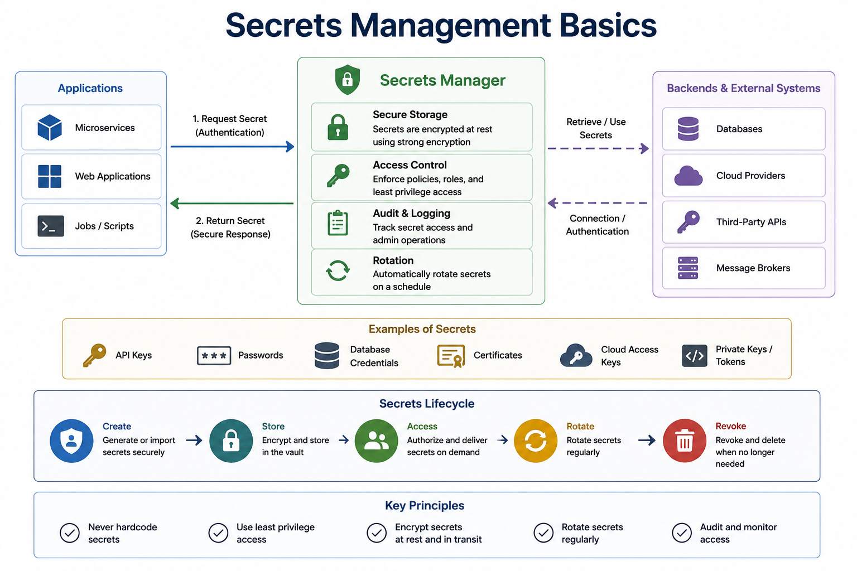
21
© 2026 by Innovation In Software Corporation
Notes:
KEY TALKING POINTS
------------------
- Applications and the request flow
Arrow 1 is Request Secret with authentication, which is the part people skip: the application must prove who it is before it receives anything.
On OpenShift that proof is usually the pod's service account identity rather than yet another password; otherwise you have only moved the problem of the first secret.
Arrow 2 returns the value over a secure channel.
Jobs and scripts are on the list on purpose, because batch jobs and CI scripts are where hardcoded credentials most often survive.
- Secrets Manager capabilities
Secure storage encrypts secrets at rest.
Access control enforces least privilege, so a policy says Transaction Service may read its own database credential and nothing else.
Audit and logging records every read and every admin change, which is what an examiner or incident responder will ask for.
Rotation replaces values on a schedule.
Note the contrast with a plain OpenShift Secret: its data is base64-encoded, and encryption at rest depends on the cluster enabling etcd encryption, so a Secret alone does not deliver all four boxes.
- Backends and external systems
The dashed arrows show the manager connecting to databases, cloud providers, third-party APIs and message brokers.
That is the dynamic secrets pattern: a vault can create a short-lived database user on demand and remove it later, so no long-lived password exists to leak.
For our platform the backends are the Account and Transaction PostgreSQL databases and the AMQ Streams Kafka cluster.
Where dynamic credentials are not supported, the manager simply stores static values that are rotated on a schedule.
- Examples of Secrets
API keys, passwords, database credentials, certificates, cloud access keys, and private keys or tokens.
Call out certificates and private keys: they expire, and an expired TLS certificate causes outages just as a leaked one causes breaches, so lifecycle tracking matters.
Tokens are on the list too, which is why Lab 3 forbids logging the Authorization header.
A Bearer token copied from a log file is a working credential until it expires.
- Secrets Lifecycle
Create or import securely, store encrypted in the vault, authorize and deliver on demand, rotate regularly, and revoke and delete when no longer needed.
Revoke is where most organizations are weakest: credentials for retired services and departed contractors can linger long after anyone remembers them.
Ask who on their team owns the revoke step when a service is decommissioned, and whether anyone would notice if it were skipped.
- Key Principles
Never hardcode secrets, use least privilege access, encrypt secrets at rest and in transit, rotate regularly, and audit and monitor access.
These five mirror the Best Practices panel on the previous slide, so use this row as a recap rather than a second lecture.
Tie each to something concrete: hardcoding to Git history, least privilege to per-service secrets, and auditing to the questions asked during an incident investigation.
REAL-WORLD EXAMPLES
-------------------
- A nightly statement-generation batch job at a bank often runs under a scheduler with a stored database credential.
Changing that job to fetch a short-lived credential from a vault at start time means a copied job definition no longer contains a working password.
- When an engineer who administered a payments database moves to another team, a lifecycle with a named owner for rotation and revocation ensures any shared admin credentials they knew are replaced, instead of discovering much later that the old password still works.
USE-CASE SCENARIO
-----------------
Walk the capstone through the diagram.
Account Service, Transaction Service and, on Day 5, Risk Assessment Service are the applications on the left.
Each authenticates with its own OpenShift service account and receives only its own credentials: Account Service gets the account_db password, Transaction Service gets its own database password, and both get the JWT validation material.
The backends on the right are PostgreSQL and AMQ Streams.
When the security team rotates the Transaction database password, the audit log shows which pods read the new value, and the old one is revoked.
In class, Lab 4 builds the simplest version: one OpenShift Secret referenced from each Deployment with secretKeyRef.

Slide 23
OPENSHIFT SECRETS · EXTERNAL SECRET STORES AND VAULTS · SECRET ROTATION
📌
OPENSHIFT SECRET EXAMPLE
📌
COMMON EXTERNAL SECRET STORES
📌
WHEN TO ROTATE SECRETS
• apiVersion: v1, kind: Secret, type: Opaque
• stringData: ACCOUNT_DB_PASSWORD: <injected securely>
• Real secret creation should follow enterprise security procedures, not ad hoc values
• HashiCorp Vault, Azure Key Vault, AWS Secrets Manager, Google Secret Manager
• Provide dynamic secrets, fine-grained access policies, and centralized audit logging
• Periodically, after suspected exposure, when team members change roles
• When service accounts are replaced, or after a security incident
KEY TAKEAWAY A Secret of type Opaque, mounted as an environment variable, keeps ACCOUNT_DB_PASSWORD out of application.yml entirely. • An external vault can issue short-lived, on-demand database credentials instead of one static password shared across every service instance. • Rotating periodically, after a suspected exposure, or when a team member changes roles limits the blast radius of any single leaked credential.
22
© 2026 by Innovation In Software Corporation
Notes:
TOPIC 1 OF 3: OpenShift Secrets
-------------------------------
KEY TALKING POINTS
------------------
- OPENSHIFT SECRET EXAMPLE
Opaque is the general-purpose type for arbitrary key-value pairs; other types exist for TLS certificates and registry pull credentials.
stringData lets you write plain values, which the API server stores base64-encoded under data, and base64 is encoding, not encryption.
The Deployment then references a key with secretKeyRef to create an environment variable, or mounts the Secret as files.
The placeholder matters: nobody should type a real bank password into YAML that lands in Git.
Real values arrive through a controlled process such as a restricted pipeline or a secrets operator.
REAL-WORLD EXAMPLES
-------------------
- A team deploying a card-authorization service keeps its Deployment YAML in Git with only secretKeyRef references, while the Secret itself is created by a restricted pipeline.
Reviewers can read every manifest without ever seeing a production credential.
- Printing all environment variables at startup is a common debugging habit that defeats Secrets entirely: the database password lands in the pod log and then in the central log store.
Many banks prohibit environment dumps in production code for exactly that reason.
USE-CASE SCENARIO
-----------------
Lab 4 on Day 4 does exactly this for the capstone.
The file openshift/02-secret.yaml defines an Opaque Secret named md287-db-secrets with stringData keys for the Account and Transaction database users and passwords plus MD287_JWT_SECRET.
The Account Deployment maps SPRING_DATASOURCE_PASSWORD to the ACCOUNT_DB_PASSWORD key through secretKeyRef, so Spring Boot picks it up by relaxed binding and application.yml never contains it.
The lab file carries a comment that these are classroom values only and real bank secrets never go in Git.
In the bank, the same manifest shape would be filled by an approved process rather than committed.
TOPIC 2 OF 3: External Secret Stores and Vaults
------------------------------------------
KEY TALKING POINTS
------------------
- COMMON EXTERNAL SECRET STORES
The four names cover a self-managed option, HashiCorp Vault, and the managed service from each major cloud.
Dynamic secrets means the vault generates a credential on request with a lease, for example a database user valid for a limited time, then revokes it, so a leaked value expires on its own.
Fine-grained policies tie reads to workload identity, such as one OpenShift service account in one namespace.
Central audit gives one place to see every read.
On OpenShift an operator often syncs vault values into native Secrets, so application code does not change.
REAL-WORLD EXAMPLES
-------------------
- A bank running workloads on both on-premises OpenShift and a public cloud often standardizes on one enterprise vault, so security teams audit credential access in one place and application teams request access through a single policy process instead of per cluster.
- With dynamic database credentials, each pod of a loan-origination service receives its own short-lived database user.
If one pod is compromised, the security team revokes that single lease without rotating a password shared by every instance.
USE-CASE SCENARIO
-----------------
Picture Transaction Service scaled out to several pods on OpenShift during a month-end spike.
With a static Secret, every pod shares one database password that may not have changed in a long time.
With a vault issuing dynamic credentials, each pod receives a unique, short-lived PostgreSQL user at startup, the vault logs each issuance against the pod's service account, and the leases expire after the pods scale down.
If a heap dump from one pod leaks, the exposed credential is already close to expiry.
The course does not install a vault; Lab 4 uses a plain OpenShift Secret, which is the right first step.
TOPIC 3 OF 3: Secret Rotation
-----------------------------
KEY TALKING POINTS
------------------
- WHEN TO ROTATE SECRETS
Periodic rotation caps the exposure window even for leaks nobody detected.
Suspected exposure means rotate first and investigate second; do not wait for proof.
Role changes matter because people who knew a shared credential still know it after they move.
Replaced service accounts leave old credentials behind unless someone revokes them.
After an incident, assume every credential the attacker could reach is compromised.
The engineering lesson is that services must tolerate rotation, picking up new values through a restart or refresh without an outage, ideally with old and new values briefly valid together.
REAL-WORLD EXAMPLES
-------------------
- When an identity provider rotates its token signing key, resource servers that fetch keys from the provider's published key set accept tokens signed with the new key automatically, while services with a hardcoded key reject every user until they are redeployed.
- Several payment platforms let a merchant hold two active API keys at once, so the team deploys the new key, confirms traffic is flowing, and only then revokes the old one.
Rotation becomes a no-downtime routine instead of a risky event.
USE-CASE SCENARIO
-----------------
Tell this story.
A developer pastes a Transaction Service log excerpt into a team chat to ask for help, and it contains a Bearer token and, worse, a debug dump that includes the datasource password.
The response is rotation in order: change the database password and update the Secret, roll the Transaction Service pods so they read it, confirm both actuator health endpoints report UP, and check the database audit trail for use of the old value.
The leaked lab JWT expires on its own, since issue-jwt.py defaults to a 12-hour lifetime, but a leaked signing secret would require changing md287.jwt.secret on both services at the same time.

Slide 24
API INPUT VALIDATION · OWASP API SECURITY RISKS · RATE LIMITING AND ABUSE PREVENTION
📌
WHAT TO VALIDATE
✅
BEST PRACTICES
• Path variables, query parameters, request bodies, headers where relevant, file uploads
• Validate all inputs on the server side; use allowlists, not denylists
• Use parameterized queries; validate files by type, size, and content
📌
TOP OWASP API RISKS
📌
WHERE AND WHY
• Broken object level authorization, broken authentication, broken object property level authorization
• Unrestricted resource consumption, broken function level authorization
• Security misconfiguration, improper inventory management
• Apply limits close to the entry point: API gateway, load balancer, or service mesh
• Use different limits for different clients or operations (login vs. balance lookup vs. payment)
• Return clear 429 responses and monitor rate-limit rejections
KEY TAKEAWAY Unvalidated input is the root cause behind injection attacks, broken object authorization, and countless other API vulnerabilities. • Customer 101 changing a URL to /accounts/5002 and getting another customer's data is exactly the failure OWASP's list is built around. • 429 Too Many Requests is the standard signal that tells a well-behaved client to back off -- applied at the gateway, closest to the entry point.
23
© 2026 by Innovation In Software Corporation
Notes:
TOPIC 1 OF 3: API Input Validation
----------------------------------
KEY TALKING POINTS
------------------
- WHAT TO VALIDATE
Every entry point is attacker-controlled.
Path variables such as an accountId can carry injection strings or someone else's identifier.
Query parameters drive filters, page sizes and sort fields, and an unbounded page size is a denial-of-service lever.
Request bodies carry amounts, currencies and types that need format and range checks.
Headers matter where the service uses them, such as X-Correlation-Id, which ends up in logs and should be limited in length and characters.
File uploads, such as identity documents for account opening, are the riskiest input of all.
- BEST PRACTICES
Server-side, because client checks are bypassed with a single curl command.
Allowlists describe what valid looks like, such as an accountId in the synthetic ACC- format, while denylists try to list bad input and always miss a case.
Parameterized queries, which Spring Data JPA uses by default, stop SQL injection even when validation misses something, so they are a second layer.
Files need their type checked by content rather than extension, plus a size limit and scanning.
In Spring Boot, bean validation on request DTOs and a global exception handler give a consistent 400.
REAL-WORLD EXAMPLES
-------------------
- A funds-transfer API that accepts a negative amount without a range check can turn a debit into a credit.
A simple allowlist rule, amount greater than zero with at most two decimal places and a per-transaction maximum, closes a hole no firewall would catch.
- Document upload during digital account opening, such as a photographed driver's license, should confirm the file really is an image or PDF by its content, enforce a size limit, and scan it before any downstream system opens it.
USE-CASE SCENARIO
-----------------
The capstone already enforces this, and the solution tests prove it.
AccountControllerTest posts a customerId of john.doe@bank.com and expects 400 with code VALIDATION_FAILED, because the API only accepts synthetic identifiers in the CUST- style.
TransactionControllerTest sends an accountId of real-customer-99 and gets the same 400.
Those rules are allowlists: they describe the valid shape instead of guessing at bad ones.
They also protect privacy, since a real email can never be stored or logged as a customer ID.
Ask the room what else Transaction Service should reject before it even calls Account Service, such as a zero amount or an unsupported currency like EUR, which TransactionServiceTest already rejects.
TOPIC 2 OF 3: OWASP API Security Risks
--------------------------------------
KEY TALKING POINTS
------------------
- TOP OWASP API RISKS
Object level: the API confirms you are logged in but never checks that account 5002 is yours.
Authentication: weak token handling, such as accepting expired or unsigned JWTs.
Object property level: exposing or accepting fields the caller should not see or set, like status in a JSON body.
Resource consumption: no limits on payload size, page size or call rate.
Function level: a readonly caller reaching a write operation, exactly the Lab 3 403 check.
Misconfiguration covers open actuator endpoints and verbose errors; inventory covers forgotten old API versions still running.
REAL-WORLD EXAMPLES
-------------------
- A statement-download endpoint that takes a sequential statement ID and only checks that the caller is logged in lets any customer step through IDs and download other customers' statements.
The fix is an ownership check on every object, not a harder-to-guess ID.
- Mass assignment, part of broken object property level authorization, happens when an account-update endpoint binds the entire JSON body onto the entity, so a caller adds a status field and unfreezes their own account.
Request DTOs containing only editable fields prevent it.
USE-CASE SCENARIO
-----------------
Map the list onto the capstone and be honest about the gap.
Function level authorization is covered in Lab 3: the teller token has no transactions.write scope, so POST /api/v1/transactions returns 403.
Authentication is covered by validating the signature, issuer and expiry on every request.
Object property level is covered by DTOs: UpdateAccountRequest carries only the nickname, so a caller cannot set status.
Object level authorization is not fully covered: an ops token can read any accountId, because lab tokens carry scopes, not customer ownership.
In production, Account Service would also check that the account belongs to the customer, or that the employee is entitled to view it.
TOPIC 3 OF 3: Rate Limiting and Abuse Prevention
------------------------------------------
KEY TALKING POINTS
------------------
- WHERE AND WHY
At the edge, because rejecting abusive traffic before it reaches Spring Boot pods and databases is far cheaper than rejecting it inside.
Different limits because risks differ: login needs strict per-user and per-IP limits against password guessing, balance lookups are frequent but scrapable, and payment submission should be tight and tied to fraud checks.
A 429 Too Many Requests with a Retry-After header tells legitimate clients when to try again, and rejection metrics reveal attacks in progress.
A Resilience4j rate limiter inside a service protects that service; gateway limits protect the platform.
REAL-WORLD EXAMPLES
-------------------
- Credential-stuffing attacks against online banking login pages replay leaked username and password pairs at high volume.
Per-account and per-IP limits at the gateway, combined with step-up authentication, make those attacks slow and visible instead of silent.
- A third-party budgeting app polling balance endpoints for many customers can strain core systems at peak hours.
Per-client quotas with clear 429 responses let the bank serve the partner fairly without degrading branch and mobile traffic.
USE-CASE SCENARIO
-----------------
Imagine Transaction Service exposed on OpenShift behind a gateway.
A misbehaving internal batch client retries POST /api/v1/transactions in a tight loop after a timeout.
Without limits it floods Transaction Service, which calls Account Service for every attempt, so one bad client can push Account Service into timeouts that open the circuit breaker and block legitimate tellers too.
With a per-client limit at the gateway, the batch client receives 429 with Retry-After, operations see the rejection metric spike, and normal traffic continues.
The course does not implement rate limiting in a lab; treat this as design knowledge for the Day 4 deployment discussions.

Slide 25
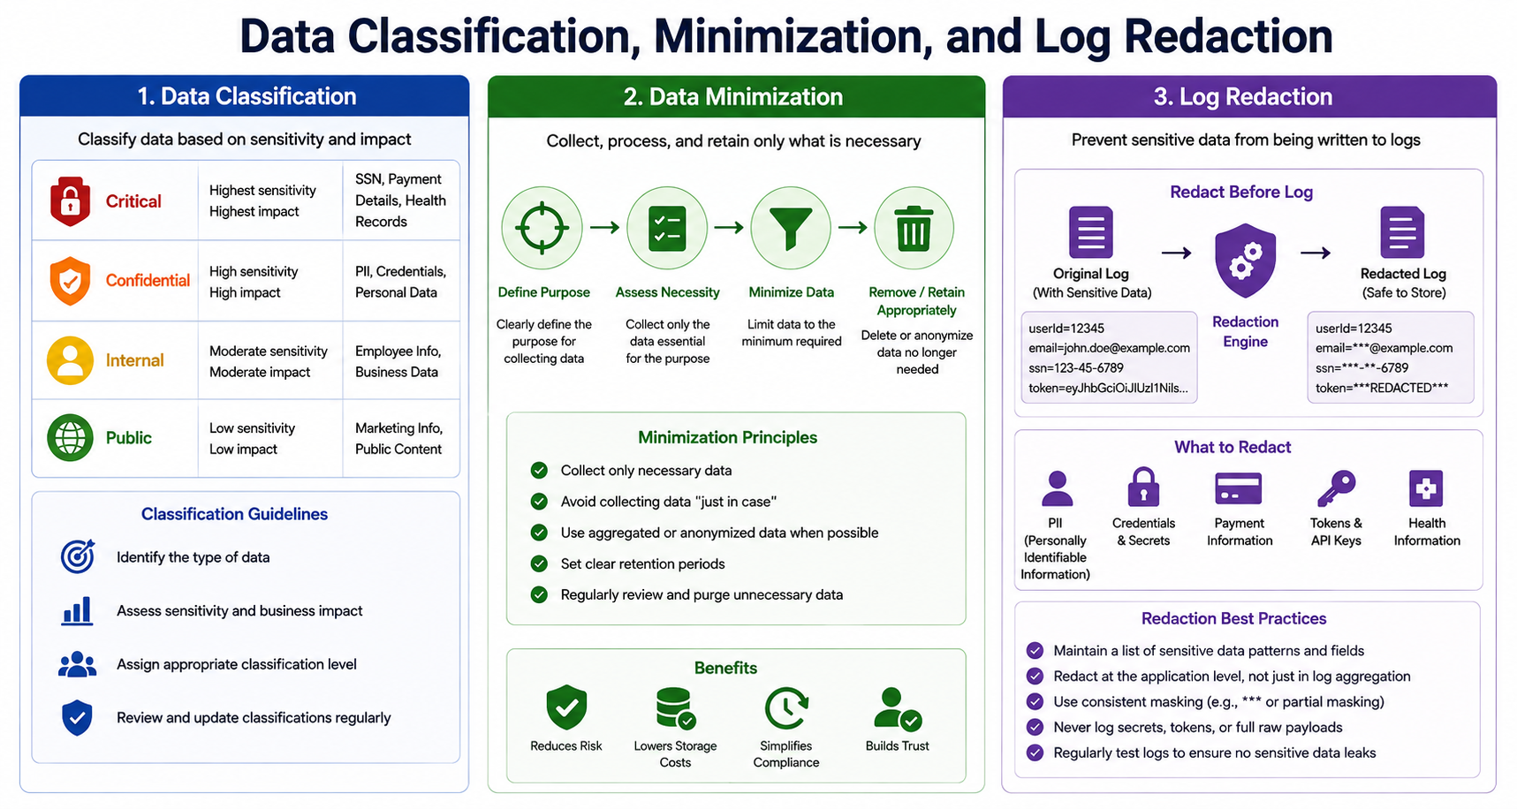
24
© 2026 by Innovation In Software Corporation
Notes:
KEY TALKING POINTS
------------------
- 1. Data Classification
Four levels by sensitivity and impact: Critical holds SSNs, payment details and health records; Confidential holds PII, credentials and personal data; Internal holds employee and business data; Public holds marketing content.
The guidelines say identify the data, assess sensitivity and impact, assign a level, and review regularly.
One caution: the diagram places credentials in Confidential, yet a database password or signing key usually deserves the highest handling, since one leak exposes everything behind it.
Always follow the bank's own classification standard over this generic scheme.
- 2. Data Minimization
The flow is define purpose, assess necessity, minimize data, then remove or retain appropriately.
The principles are collect only what is necessary, avoid collecting just in case, prefer aggregated or anonymized data, set retention periods, and review and purge.
The benefits row lists reduced risk, lower storage cost, simpler compliance and more trust.
In banking, retention is a balance: regulations require keeping certain records for defined periods, so minimization means keeping what is required for as long as required, then deleting it.
- 3. Log Redaction: Redact Before Log
The top of the purple column shows an original log line with a userId, a full email, a full SSN and a JWT, passing through a redaction engine to a line where the email is masked, the SSN shows only its last four digits, and the token is replaced by a redacted marker.
Stress the direction: redaction happens in the application before the line is written.
The token in the original line is exactly the kind of Bearer value Lab 3 says must never be logged.
- What to Redact and Redaction Best Practices
Redact PII, credentials and secrets, payment information, tokens and API keys, and health information.
The practices: keep a list of sensitive fields and patterns, redact at the application level rather than only in log aggregation, use consistent masking, never log secrets, tokens or full raw payloads, and test logs regularly for leaks.
Full raw payloads is the quiet one: logging an entire request body at debug level captures every sensitive field inside it.
REAL-WORLD EXAMPLES
-------------------
- Card numbers are the classic case.
PCI DSS requires stored card numbers to be rendered unreadable, and log files count as storage, so card-processing services mask all but the last digits before logging and scan log stores for number patterns that slipped through.
- A loan-application service collects employer and income details for underwriting.
Minimization means those fields stay in the underwriting system with a defined retention period rather than being copied into a marketing analytics warehouse just in case.
USE-CASE SCENARIO
-----------------
The capstone is built on synthetic data so minimization and redaction are designed in.
Account Service accepts identifiers like CUST-0001 and rejects a real-looking email with 400.
Lab 3's log checklist says each line should carry accountId, transactionId and correlationId, and must not contain the Authorization header, a JWT payload dump with scope or sub, or a fake ACTIVE status on the 503 path.
Now look ahead to Day 5, when Risk Assessment Service asks a model on OpenShift AI to help score a transaction: classification decides which fields may go into a prompt, minimization sends only amount, type and account status, and redaction keeps prompts and responses free of tokens and personal data.

Slide 26
SECURITY LOGGING AND AUDIT TRAILS · DATA ENCRYPTION AT REST AND IN TRANSIT · PERSONALLY IDENTIFIABLE INFORMATION
📌
WHAT TO LOG
⚠️
WHAT NEVER TO LOG
• Failed login attempts, access denied events, account updates
• Payment creation, admin operations, secret rotation, high-risk AI tool calls
• Passwords, tokens, full account numbers, secret values, sensitive personal data
📌
TWO ENCRYPTION DOMAINS
📌
PROTECTING PII
• In transit: TLS 1.2+ for all client and service-to-service traffic
• At rest: encrypted databases, encrypted disks, and encrypted backups
• Use secure key management -- never hardcode encryption keys
• Minimize collection of sensitive data to only what's necessary
• Mask, tokenize, or pseudonymize PII when full values aren't required
• Never log PII, and encrypt it both at rest and in transit
KEY TAKEAWAY Audit logs answer 'who did what, when' after an incident -- but only if they were captured consistently before the incident happened. • TLS protects data in transit; database and disk-level encryption protects data at rest -- a complete strategy needs both, not just one. • Names, addresses, SSNs, and account numbers are exactly the data a banking platform must protect most carefully across every system that touches it.
25
© 2026 by Innovation In Software Corporation
Notes:
TOPIC 1 OF 3: Security Logging and Audit Trails
------------------------------------------
KEY TALKING POINTS
------------------
- WHAT TO LOG
Log the events an investigator will ask about.
Failed logins and access denied events reveal probing, such as a teller token repeatedly receiving 403 on transaction POSTs.
Account updates and payment creation are the business actions fraud teams and auditors reconstruct.
Admin operations and secret rotation show who changed the system itself.
High-risk AI tool calls matter from Day 5: if an AI assistant triggers an action, the trail must show which tool, on whose behalf, and the outcome.
Each entry needs who, what, when, outcome and a correlation ID.
- WHAT NEVER TO LOG
Passwords and secret values are obvious, but tokens are the item teams miss: a Bearer token copied from a log works as a credential until it expires.
Full account numbers and sensitive personal data turn the log platform into a second, less protected customer database, often with broader access than the source system.
Log an internal or synthetic ID, or a masked value, instead.
Also avoid logging whole request bodies and exception messages that echo input, because they carry these values indirectly.
REAL-WORLD EXAMPLES
-------------------
- When a customer disputes a transfer, investigators reconstruct the sequence: authentication, the transfer request, the approval decision and any account changes.
With consistent events and correlation IDs the answer is quick; without them it may be impossible to prove what happened.
- A frequent code review finding is a request-logging filter that prints all headers for debugging.
In production that filter writes every caller's Bearer token into central logs, readable by anyone who has log access.
USE-CASE SCENARIO
-----------------
Lab 3 builds both halves.
In Step 4 students POST a transaction with X-Correlation-Id lab3-demo and confirm that Account Service's log shows the relayed GET with the same correlation ID, and that neither log line contains the word Bearer.
That is an audit trail in miniature: which account, what outcome, linked across two services.
Extend it for the room: when the teller token tries to POST a transaction and receives 403, that denial is a security event worth recording with the endpoint, outcome and correlation ID.
A production audit record would add a user identifier from a controlled source, but never the raw token or a dump of its claims.
TOPIC 2 OF 3: Data Encryption at Rest and in Transit
------------------------------------------
KEY TALKING POINTS
------------------
- TWO ENCRYPTION DOMAINS
In transit stops someone on the network path from reading or altering traffic, and that includes calls between pods, not just the internet edge, because internal networks get compromised too.
TLS 1.2 is the floor and TLS 1.3 is preferred where supported.
At rest stops someone with a stolen disk, snapshot or backup from reading data; backups are often forgotten and are exactly what gets copied offsite.
Key management ties both together: keys live in a key management service or hardware security module with access control and rotation, never in code or config.
REAL-WORLD EXAMPLES
-------------------
- Core banking database backups are commonly copied to a separate site for disaster recovery.
Encrypting them at rest, with keys held separately from the backups, means a lost backup or a misconfigured storage location does not become a customer data breach.
- Service-to-service TLS matters inside the data center.
If an attacker compromises one internal host, unencrypted calls between payment services would expose card data and tokens to simple packet capture on that network.
USE-CASE SCENARIO
-----------------
Be precise about the capstone.
In the Day 3 labs everything runs on localhost over plain HTTP, and PostgreSQL runs in a local container from docker compose, which is acceptable for synthetic data on a laptop and nowhere else.
On Day 4 the services move to OpenShift, where routes can terminate TLS, and a production design would add encryption between Transaction Service and Account Service, TLS to PostgreSQL and to AMQ Streams, and encrypted storage and backups for both databases.
Ask the room to list every network hop in the platform and name which ones carry a Bearer token; every one of those must be encrypted.
TOPIC 3 OF 3: Personally Identifiable Information
------------------------------------------
KEY TALKING POINTS
------------------
- PROTECTING PII
The safest PII is the field you never stored.
Masking shows part of a value, such as the last four digits of an account number on a statement screen.
Tokenization replaces the value with a random token and keeps the mapping in a secured vault, so downstream systems work with tokens only.
Pseudonymization replaces identity with a consistent stand-in, which keeps analytics possible while hiding who the person is.
Never logging PII and encrypting it everywhere closes the two most common leak paths: log stores and unencrypted copies of data.
REAL-WORLD EXAMPLES
-------------------
- Card tokenization is widely used in payments: merchants and mobile wallets hold a token that stands in for the real card number, so a breach of those systems does not expose card numbers that can be used elsewhere.
- A fraud analytics team can build models on pseudonymized customer IDs and transaction patterns without seeing names or SSNs.
Only a controlled re-identification process can link a flagged pattern back to a real customer.
USE-CASE SCENARIO
-----------------
Our platform shows pseudonymization by design.
Account Service keys records on values such as CUST-0001 and ACC-AABBCCDD, and Transaction Service and the TransactionSubmitted Kafka event carry only the transaction and account IDs, amount, currency and type.
No name, address or SSN ever travels between services.
When Risk Assessment Service arrives on Day 5, it works from those same fields.
Ask the room: if the business later wants the customer's name shown on a risk alert, which service should look it up, at what moment, and who should be allowed to see it?
Good answers keep the lookup at the display edge with its own access check.

Slide 27
SECURITY AND COMPLIANCE CONTROLS · THREAT MODELING MICROSERVICES · ZERO-TRUST ARCHITECTURE
📌
WHY COMPLIANCE CONTROLS MATTER
📌
THE THREAT MODELING PROCESS
✅
BEST PRACTICES
• Regulatory and contractual obligations (e.g., GDPR, HIPAA-style requirements) shape required controls
• Controls must be documented, testable, and auditable -- not just implemented
1. Define scope 2. Create architecture view 3. Identify threats (STRIDE)
4. Assess risks 5. Mitigate & validate 6. Monitor & iterate
• Model early and often; include automated checks in CI/CD pipelines
• Prioritize risks based on business impact; validate controls with testing (SAST/DAST, pen tests)
📌
ZERO-TRUST PRINCIPLES
✅
ZERO TRUST IN MICROSERVICES
• Verify explicitly, use least-privilege access, assume breach
• Reduce attack surface, continuously monitor and re-validate
• mTLS between services, fine-grained RBAC/ABAC authorization
• API gateway with policy enforcement, observability across traces, logs, and metrics
KEY TAKEAWAY Compliance frameworks translate 'be secure' into specific, auditable controls a banking platform must demonstrably satisfy. • STRIDE -- spoofing, tampering, repudiation, information disclosure, denial of service, elevation of privilege -- gives every threat a name and a category. • Never trust, always verify, least privilege, assume breach -- four principles that replace perimeter-based security with continuous verification.
26
© 2026 by Innovation In Software Corporation
Notes:
TOPIC 1 OF 3: Security and Compliance Controls
------------------------------------------
KEY TALKING POINTS
------------------
- WHY COMPLIANCE CONTROLS MATTER
Obligations come from regulation, from industry standards such as PCI DSS for card data, and from contracts with partners.
GDPR and HIPAA are illustrations; for a US bank the Gramm-Leach-Bliley Act on customer financial privacy, PCI DSS and banking regulators' supervisory expectations are more directly relevant.
Documented means someone can read what the control is.
Testable means an automated test or check proves it works.
Auditable means evidence is retained, such as pipeline results and access logs.
Engineers help most by turning controls into tests that run on every build.
REAL-WORLD EXAMPLES
-------------------
- A control such as every business API rejects unauthenticated calls becomes auditable when security tests like the ones in Lab 3 run in the CI pipeline on every commit and the pipeline keeps the results as evidence.
- PCI DSS requires restricting access to cardholder data by business need to know.
Teams demonstrate it with role definitions, periodic access reviews and logs of denied attempts, not simply a statement that access is restricted.
USE-CASE SCENARIO
-----------------
Frame Lab 3 as compliance evidence.
Suppose internal audit asks the Transaction Service team to prove that only authorized operators can submit transactions.
The team shows the documented scope matrix: teller holds accounts.read and accounts.write, ops holds accounts.read plus transactions.read and transactions.write, readonly holds only read scopes.
They show the test: TransactionSecurityTest expects 401 with no token and 403 when a caller holding only transactions.read tries to POST.
They show the evidence: a Day 4 pipeline can run mvn test on every change and keep the results.
Documented, testable and auditable, all from work the students complete today.
TOPIC 2 OF 3: Threat Modeling Microservices
------------------------------------------
KEY TALKING POINTS
------------------
- THE THREAT MODELING PROCESS
Scope picks one flow, such as submitting a transaction.
The architecture view is a data flow diagram with trust boundaries where data crosses from client to service to database or broker.
STRIDE asks six questions at each boundary: spoofing identity, tampering with data, repudiation or denying an action, information disclosure, denial of service, and elevation of privilege.
Assess ranks each by likelihood and impact, mitigate assigns a control and a test, and monitor revisits the model when the design changes.
The slide's numbering drops the 1 and the 4; the six steps simply run in order.
- BEST PRACTICES
Early means at design time, when fixing a flaw is a whiteboard change rather than a rewrite.
Often means at every significant change, such as adding Risk Assessment Service.
Automated checks in CI/CD catch regressions of mitigations already agreed.
Prioritizing by business impact keeps effort on money movement and customer data.
SAST scans source code for insecure patterns, DAST probes the running application from outside, and penetration testers find what tools miss; each validates different kinds of controls.
REAL-WORLD EXAMPLES
-------------------
- Before launching a person-to-person payments feature, a bank team threat-models the send-money flow and flags repudiation, a customer denying they sent a payment, as a key risk.
The mitigation is a tamper-evident audit record with authentication and device details.
- A DAST scan of a staging environment can reveal that actuator endpoints beyond health expose environment details without authentication, a misconfiguration that SAST would miss because the source code itself looks perfectly normal.
USE-CASE SCENARIO
-----------------
Run a two-minute STRIDE pass on the Lab 3 flow from ops user to Transaction Service to Account Service to Kafka.
Spoofing: a forged JWT, mitigated by signature and issuer validation.
Tampering: altering an amount in transit or in the event, mitigated by TLS and broker access control in production.
Repudiation: an operator denies submitting, mitigated by correlation-ID logs.
Information disclosure: tokens in logs, mitigated by the Lab 3 log checklist.
Denial of service: Account Service down, mitigated by the timeout, circuit breaker and 503 fallback.
Elevation of privilege: a teller posting transactions, mitigated by the 403 scope check.
One diagram, six threats, all tied to today's lab.
TOPIC 3 OF 3: Zero-Trust Architecture
-------------------------------------
KEY TALKING POINTS
------------------
- ZERO-TRUST PRINCIPLES
Verify explicitly means every request is authenticated and authorized using identity and context, not network location.
Least privilege means callers get only the scopes they need, like readonly holding only read scopes.
Assume breach means designing as if one pod is already compromised and limiting what it can reach.
Reducing attack surface removes unused endpoints, ports and dependencies.
Continuous monitoring and re-validation mean short-lived tokens and ongoing checks rather than one login trusted all day.
Perimeter security trusted the inside; zero trust treats the inside like the internet.
- ZERO TRUST IN MICROSERVICES
mTLS gives each service a certificate identity, so Account Service can verify the caller really is Transaction Service, and it encrypts the traffic; on OpenShift this is commonly provided by a service mesh rather than application code.
RBAC grants by role or scope, while ABAC adds attributes such as account ownership, amount or time of day.
The gateway centralizes token checks, limits and policies at the edge.
Observability is how you re-validate continuously, because you cannot detect abuse you cannot see.
Lab 3 implements the token part; mTLS and a mesh stay lecture topics.
REAL-WORLD EXAMPLES
-------------------
- Google has publicly described its BeyondCorp program, which moved employee access away from trusting the corporate network toward per-request checks of user and device.
It is widely cited as an early large-scale zero-trust implementation.
- In a bank's payments platform, a compromised internal reporting service should not be able to call the funds-transfer API just because it sits on the same network segment.
Workload identity through mTLS plus per-service authorization blocks that lateral movement.
USE-CASE SCENARIO
-----------------
Contrast two versions of the capstone.
The Lab 3 starter still permits all requests, so Account Service trusts any caller that can reach it.
If an attacker lands in any pod on that network, they can read every account.
Lab 3 then applies verify explicitly: Account Service demands a valid JWT with accounts.read on every GET, and Transaction Service relays the caller's own token instead of acting as a superuser.
That is user-delegated least privilege.
A production version would add mTLS so Account Service also verifies which workload is calling, and network policies so only Transaction Service pods can reach Account Service at all.

Slide 28
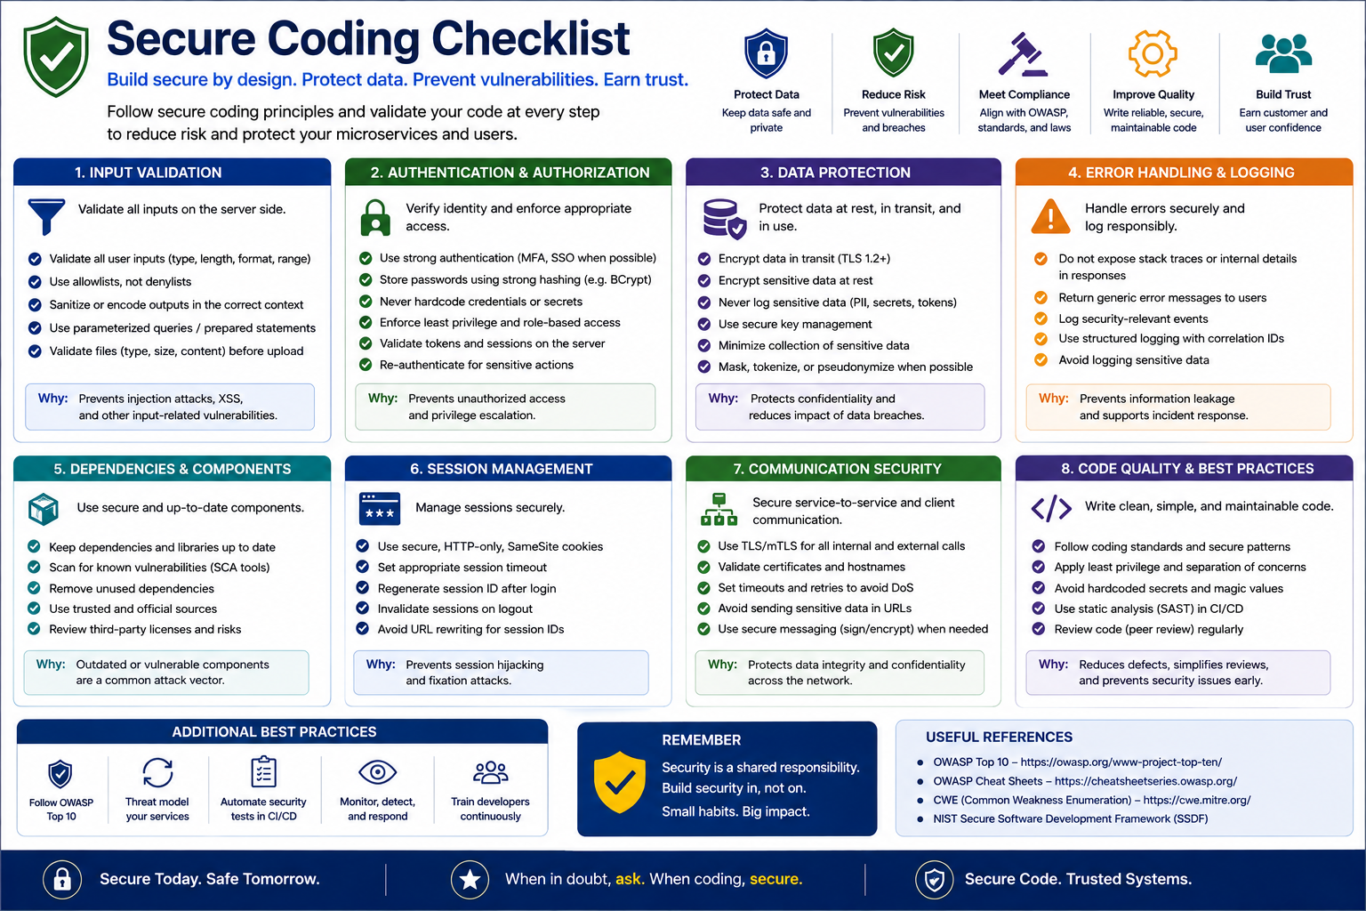
27
© 2026 by Innovation In Software Corporation
Notes:
KEY TALKING POINTS
------------------
- CHECKLIST AREAS
Input validation: constrain type, length, format and range at the edge and reject bad input instead of cleaning it; output encoding is a separate concern.
Authentication and authorization on every request, internal calls included.
Data protection: encrypt sensitive fields and keep secrets out of code.
Error handling: a safe, consistent error body for clients with detail kept in server logs.
Dependencies: pin, scan and patch in the build.
Sessions: short-lived tokens, and never trust identity a client asserts without a verified signature.
Communication: TLS with proper certificate validation.
Code quality: review, lint and test.
- REMEMBER
Security is a shared responsibility: build it in, not on.
Bolted on means a security review at the end that finds problems when fixing them is expensive and schedule pressure usually wins.
Built in means developers apply the checklist while writing code, pipelines enforce it automatically, and security specialists set standards and review the high-risk parts.
The practical ask for this room is to make the eight areas part of pull request review, rather than waiting for a penetration test to find them.
REAL-WORLD EXAMPLES
-------------------
- The Log4Shell vulnerability disclosed in December 2021 showed why the dependencies card matters: a flaw in a widely used Java logging library affected a vast number of applications, and organizations with dependency inventories and automated scanning located affected services far faster.
- Returning a raw database exception to a mobile banking client can reveal table names and query structure.
A global exception handler that returns a stable error code and logs the stack trace server-side with a correlation ID gives support what it needs without helping an attacker.
USE-CASE SCENARIO
-----------------
Use the checklist as a Lab 3 pull request review.
Input validation: request DTOs reject non-synthetic IDs with 400.
Authentication and authorization: SecurityConfig requires scopes on every business endpoint while health stays public.
Data protection: tokens and claims stay out of logs.
Error handling: SecurityJsonHandlers return JSON 401 UNAUTHENTICATED and 403 ACCESS_DENIED without stack traces.
Dependencies: the Spring Boot 3.4 parent manages versions, and a Day 4 pipeline could scan them.
Sessions: issue-jwt.py tokens expire.
Communication: plain HTTP on localhost is the known production gap.
Code quality: mvn test runs the security and circuit breaker tests.
One gap is deliberate: the JWT secret sits in application.yml for class only.

Slide 29
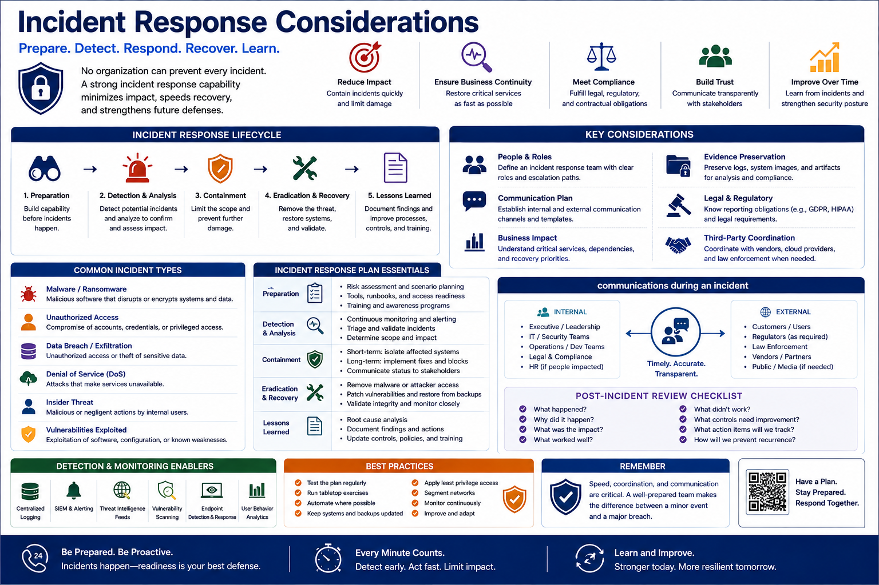
28
© 2026 by Innovation In Software Corporation
Notes:
KEY TALKING POINTS
------------------
- THE FIVE-STAGE LIFECYCLE
Preparation means roles, runbooks and contacts agreed before anything happens.
Detection and analysis confirms the event is real and measures its reach, including which data is involved.
Containment stops the spread first: revoke tokens, rotate secrets, isolate pods, before cleaning up.
Eradication and recovery removes the cause, restores service and verifies it is clean.
Lessons learned is a blameless review that produces engineering work.
The common reference, NIST SP 800-61, has traditionally grouped containment, eradication and recovery into one phase; the five-stage split says the same thing in finer steps.
- POST-INCIDENT REVIEW QUESTIONS
What happened, why and with what impact establish the facts and root cause without blame.
What worked and what did not credit the controls that helped, such as an alert that fired or a circuit breaker that contained a failure.
What controls need improvement turns the review into tracked action items with owners.
The diagram's checklist adds how we will prevent recurrence, which separates a real review from a meeting.
Blameless matters: engineers who fear punishment hide the details the review needs.
REAL-WORLD EXAMPLES
-------------------
- When a critical vulnerability in a widely used library is announced, a bank's response follows these stages: detect which services use it, contain by blocking exploit patterns at the edge, eradicate by patching, and review how quickly the dependency inventory answered the question.
- An API key found by a secret scanner in a public code repository is a small incident that still needs the full cycle: revoke the key immediately, check access logs for use, issue a replacement, and review how it reached the repository.
USE-CASE SCENARIO
-----------------
Run a mini tabletop on the capstone.
One morning an alert shows Transaction Service returning 503 ACCOUNT_SERVICE_UNAVAILABLE with the circuit breaker open.
Detection and analysis: outage or attack?
Correlation-ID logs show Account Service pods restarting after a bad configuration change, with no authentication anomalies.
Containment is partly automatic: the breaker fails fast and no transaction is auto-approved, so no money moves against an unverified account.
Recovery: roll back the change and confirm health is UP and the circuit closes.
Lessons learned: add a configuration check to the pipeline.
Then change one fact: a Bearer token and the signing secret appear in a support ticket.
Now containment means rotating the secret on both services.

Slide 30
EXERCISE 3.2 — SECURE AN ENDPOINT WITH JWT ROLES/SCOPES
Module 7 checkpoint B — Roles/scopes on protected APIs.
🎯
OBJECTIVE
📝
DO THIS
✅
EXPECTED RESULT
• Roles/scopes on protected APIs
• 10 min · code warmup checkpoint
• Worksheet: curriculum/day-03/exercises/exercise-3.2-jwt-roles-scopes.md
1. No Bearer token → 401. Wrong scope → 403 (not a silent 200)
2. teller: accounts.read/write. ops: transactions + accounts.read. readonly: *.read
3. Transaction Service forwards the caller's JWT when it GETs Account Service
4. Never log Authorization headers or JWT claims
• A scope matrix you can test with issue-jwt.py teller / ops / readonly.
• Lab 3 uses issue-jwt.py (HMAC). Keycloak / Azure AD are lecture only.
KEY TAKEAWAY A scope matrix you can test with issue-jwt.py teller / ops / readonly.
29
© 2026 by Innovation In Software Corporation
Notes:
KEY TALKING POINTS
------------------
- OBJECTIVE
The goal is to design authorization before coding it.
In ten minutes, pairs or groups of three produce a matrix of token type against endpoint, with the expected status code in each cell.
It is a warmup for Lab 3 Steps 2 to 4, so the matrix they write is the one they will prove with curl.
Keep scope to Account, Transaction and Risk Assessment services only, as the worksheet's success criteria require.
Budget about two minutes to brief, six to work and two to debrief.
- DO THIS
401 means we do not know who you are: missing, expired or badly signed token.
403 means we know who you are and you are not allowed.
A silent 200 on a wrong scope is the worst outcome because nobody notices.
Teller holds accounts.read and accounts.write; ops holds accounts.read, transactions.read and transactions.write; readonly holds accounts.read and transactions.read.
Transaction Service relays the caller's JWT, which is why ops needs accounts.read.
Logs keep accountId, status and correlation ID, never the Authorization header or claims.
- EXPECTED RESULT
A good matrix has rows for teller, ops, readonly and no token, and columns for account create, activate, freeze, close and GET, plus transaction POST and GET.
Key cells: teller POST transaction is 403, ops GET account is 200, readonly on any write is 403, and no token is 401 on every business endpoint while actuator health stays public.
Lab 3 signs tokens with an HMAC secret through tools/issue-jwt.py as a classroom shortcut; in production Keycloak or Microsoft Entra ID would issue tokens signed with asymmetric keys.
REAL-WORLD EXAMPLES
-------------------
- In branch banking, tellers can open and service accounts but cannot release wire transfers, while payment operations staff release transfers but cannot change account details.
That separation of duties is exactly what a scope matrix encodes and what 403 tests prove.
- Auditors and reporting users often need read access to transaction history with no ability to change records.
That maps to a readonly role with read scopes only, which is easy to verify with a 403 test on every write endpoint.
USE-CASE SCENARIO
-----------------
Run it like this.
Show the four DO THIS lines, form pairs, and point everyone to the worksheet.
Ask them to draw the matrix, then trace one tricky request: the ops user POSTs a transaction for account ACC-AABBCCDD.
Transaction Service checks transactions.write, then calls GET on Account Service with the same Bearer token, where Account Service checks accounts.read.
Ask what happens if the relay is missing.
Good answers say Account Service returns 401 and the transaction fails even for a valid ops user, which matches a Lab 3 troubleshooting row.
Debrief with three questions: which cell surprised you, why is 403 better than a silent 200, and where would customer ownership checks go in production?

